Slide 1
Vocabulary:
-phobia

Slide 2
-Phobia
The human mind is capable of great imagination. A great imagination is also developed through great exaggeration. When exaggeration is combined with high levels of anxiety, certain fears, or phobias, can develop. Traumatic events, too, can develop into phobias.
Phobias, then, are “a type of anxiety disorder created from a fear of something that poses little or no real danger.”

Slide 3

Ailurophobia (N)
Fear of cats

Slide 4
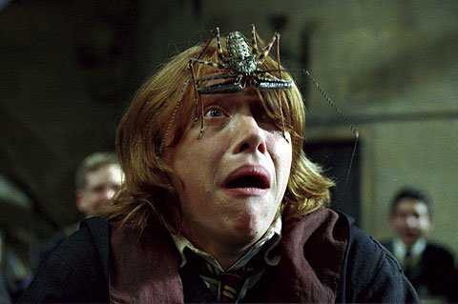
Arachnophobia (N)
Fear of spiders

Slide 5

Acrophobia (N)
Fear of heights

Slide 6

Graphophobia (N)
Fear of writing

Slide 7
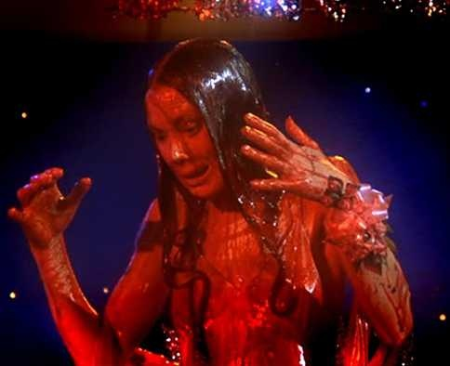

Hemophobia (N)
Fear of blood

Slide 8

Hydrophobia (n)
Fear of water

Slide 9

Ornithophobia (N)
Fear of birds

Slide 10

Photophobia (N)
Fear of light

Slide 11
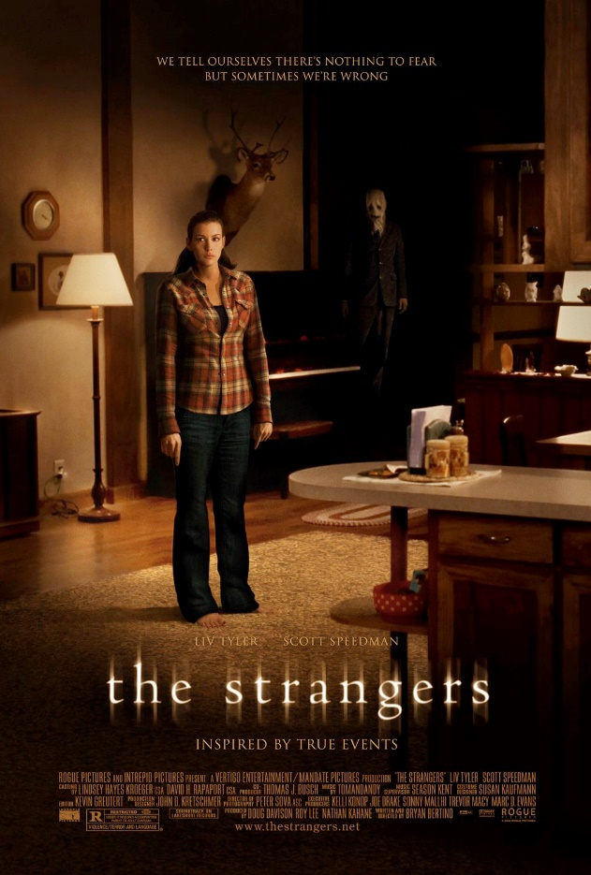
Xenophobia (N)
Fear of strangers or foreigners

Slide 12

Friggaphobia (N)
(Friggatriskaidekaphobia)
Fear of Fridays
(number 13)

