Slide 1
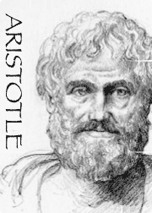
The Art of Rhetoric
—Ethos, Pathos, Logos—
The 3 Pillars of Public Speaking

Slide 2
2300 Years Ago . . .
Ethos, Pathos, Legos
Aristotle first believed that if a speaker included Logos—the facts—to persuade audiences, the speaker would need nothing else.
But, as a philosopher Aristotle also felt that Logos was not more important than the other two pillars—Ethos and Pathos. And, that Logos alone was not sufficient to appeal to audiences.

Slide 3
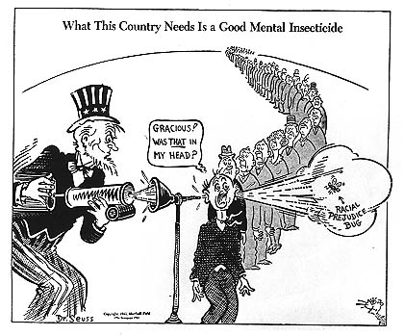
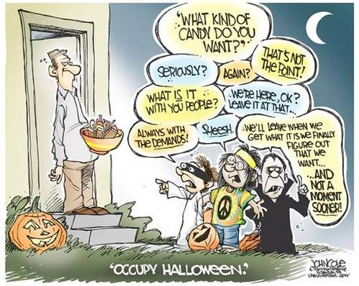
Ethos is
Ethos

Slide 4
Ethos is
. . . an ethical appeal or a means to convince an audience of the author’s credibility or character.
. . . a reference to Aristotle and his “three artistic proofs.”

Slide 5
Ethos is
The Greek word for character, “ethos” can be developed by . . .
choosing contextual words that are appropriate for the audience and topic.
introducing your expertise
using correct grammar and syntax
choosing words that are appropriate for your audience
being fair and unbiased

Slide 6
Ethos is
. . . measured by four root characteristics and how each is perceived by the audience:
Trustworthiness as perceived by the audience
Similarity to the audience
Authority relative to the audience
Expertise related to the topic

Slide 7
Trustworthiness
Ethos is
The speaker’s trustworthiness is enhanced if the audience believes he has a strong moral character that is measured by
Honesty
Generosity
Benevolence

Slide 8
Similarity to the Audience
Ethos is
The speaker’s audience is more receptive to persuasion if they can identify with the speaker in one or more ways. Like Trustworthiness—this is independent of the topic.
Adapt language, mannerisms, and tone
Career or Affiliation
Personality
Socio-economic status

Slide 9
Authority
Ethos is
Authority is the relationship between the speaker and the audience. Every speaker has some “authority,” how much depends upon how you present yourself.
Organizational—CEO, manager, supervisor
Political—president, leader, board member
Religious—priest, nun, pastor
Educational—professor, principal, teacher
Elder—a speaker older than the general audience

Slide 10
Reputation or Expertise
Ethos is
Expertise is what the speaker knows about the topic.
Reputation is what the audience knows the speaker knows about the topic.
Of the four characteristics, reputation is the “most” connected to the presentation.
Experience
Skill
Achievements or Recognition

Slide 11
Ethos is
Unlike Pathos and Logos the speaker’s Ethos is usually established “before” the presentation begins. But, Ethos can be increased or established just as easily during a presentation—through the inclusion of personal details—as it can before the presentation.
Positive Ethos can give a speaker more leeway with the audience if they present badly, but poor Ethos and a poor speech together will usually lead to disaster.

Slide 12
Democratic Presidential Candidate Acceptance Speech
Ethos Example
"I will end this war in Iraq responsibly, and finish the fight against al Qaeda and the Taliban in Afghanistan. I will rebuild our military to meet future conflicts. But I will also renew the tough, direct diplomacy that can prevent Iran from obtaining nuclear weapons and curb Russian aggression. I will build new partnerships to defeat the threats of the 21st century: terrorism and nuclear proliferation; poverty and genocide; climate change and disease. And I will restore our moral standing, so that America is once again that last, best hope for all who are called to the cause of freedom, who long for lives of peace, and who yearn for a better future."
Barack Obama
August 28, 2008

Slide 13
State of the Union Message
Ethos Example
I have pledged myself and my colleagues in the cabinet to a continuous encouragement of initiative, responsibility and energy in serving the public interest. Let every public servant know, whether his post is high or low, that a man's rank and reputation in this Administration will be determined by the size of the job he does, and not by the size of his staff, his office or his budget. Let it be clear that this Administration recognizes the value of dissent and daring -- that we greet healthy controversy as the hallmark of healthy change. Let the public service be a proud and lively career. And let every man and woman who works in any area of our national government, in any branch, at any level, be able to say with pride and with honor in future years: “I served the United States Government in that hour of our nation's need.”
John F. Kennedy
January 30, 1961

Slide 14
Democratic National Convention Keynote Address
Ethos Example
If, in my low moments, in word, deed or attitude, through some error of temper, taste, or tone, I have caused anyone discomfort, created pain, or revived someone's fears, that was not my truest self. If there were occasions when my grape turned into a raisin and my joy bell lost its resonance, please forgive me. Charge it to my head and not to my heart. My head--so limited in its finitude; my heart, which is boundless in its love for the human family. I am not a perfect servant. I am a public servant doing my best against the odds.
Jesse Jackson
1984

Slide 15
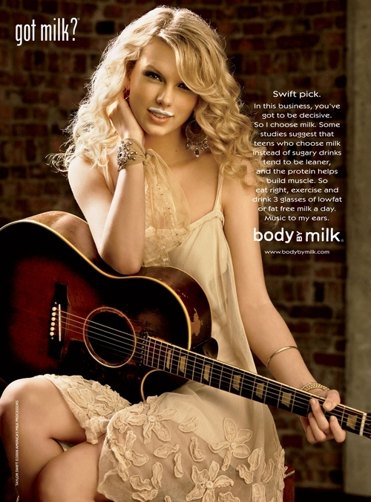
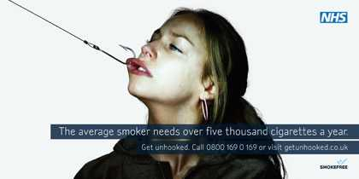
. . . in Media
Ethos Examples

Slide 16
Pathos
Pathos

Slide 17
Pathos is
. . . an emotional appeal or a means to persuade the audience by appealing to their emotions.
. . . the Greek word for both “suffering” and “experience.” The word pathetic is derived from pathos. As well as empathy, pathology, sympathy, and antipathy.

Slide 18
Pathos is
Pathos is developed by using meaningful language, emotional tone, emotion evoking examples, stories of emotional events, and implied meanings to get the audience to feel what the author feels.
Evokes sympathy from an audience
Draws pity from the audience
Inspires anger in order to prompt action

Slide 19
Pathos is
Which emotions should a speaker bring to the audience’s mind?
Joy or sadness
Trust or disgust
Fear or anger
Surprise or anticipation
Optimism or disappointment
Love or remorse
Submission or contempt
Awe or aggressiveness
The answer is . . . all of them and every emotion in between.

Slide 20
Will any emotion do?
Pathos is
The answer is, no. The emotion must be appropriate for the context of the presented material and the audience.
Positive emotions (joy, awe, surprise):
Should be associated with the speaker’s claims or “side” of the argument.
Negative emotions (fear, contempt, anger):
Should be associated with the opponent’s claims or “side” of the argument.

Slide 21
Pathos is
There is no “one” set of emotions to include to embrace all audiences. The goal of any speaker or writer is to:
Be aware of the wide range of emotions
Decide which emotions to arouse
Learn how these emotions can be induced within the speaker’s audience
Can you think of any examples from media that would evoke Pathos?

Slide 22
Pathos Examples
Pathos is
Commercials:
ASPCA
Christian Children’s Fund
Hallmark
Mastercard (“watching . . . Priceless!”)
Literature:
Cinderella stories
Romeo and Juliet

Slide 23
“I Have A Dream”
Pathos Example
I am not unmindful that some of you have come here out of great trials and tribulations. Some of you have come fresh from narrow jail cells. And some of you have come from areas where your quest -- quest for freedom left you battered by the storms of persecution and staggered by the winds of police brutality. You have been the veterans of creative suffering. Continue to work with the faith that unearned suffering is redemptive. Go back to Mississippi, go back to Alabama, go back to South Carolina, go back to Georgia, go back to Louisiana, go back to the slums and ghettos of our northern cities, knowing that somehow this situation can and will be changed.
Martin Luther King Jr.
August 28, 1963

Slide 24
“An Argument for Parental Leave in the United States”
Pathos Example
Kimberly N. had a senior position at a charitable organization when her son was born. She planned for a six-week maternity leave, but her son was born with a life-threatening condition, and she ended up taking 12 weeks with partial pay. Kimberly’s supervisor was unhappy that she took such a long leave and refused to let her work part-time or from home. After going back to work, Kimberly had a terrible performance evaluation that contrasted sharply with her previous positive evaluations. She soon left her job, which significantly impacted family finances. Savings quickly dwindled, debts grew, and Kimberly filed for bankruptcy. A few months later, she found a part-time job at a lower level with no benefits but was laid off when the recession hit. She worries that future employers will question her period of unemployment.
Janet Walsch
February 23, 2011

Slide 25
“The Boys of Point Du Hoc” Normandy France
Pathos Example
The Rangers looked up and saw the enemy soldiers -- at the edge of the cliffs shooting down at them with machine guns and throwing grenades. And the American Rangers began to climb. They shot rope ladders over the face of these cliffs and began to pull themselves up. When one Ranger fell, another would take his place. When one rope was cut, a Ranger would grab another and begin his climb again. They climbed, shot back, and held their footing. Soon, one by one, the Rangers pulled themselves over the top, and in seizing the firm land at the top of these cliffs, they began to seize back the continent of Europe. Two hundred and twenty-five came here. After two days of fighting, only 90 could still bear arms.
Behind me is a memorial that symbolizes the Ranger daggers that were thrust into the top of these cliffs. And before me are the men who put them there.
These are the boys of Pointe de Hoc. These are the men who took the cliffs. These are the champions who helped free a continent. These are the heroes who helped end a war.
Gentlemen, I look at you and I think of the words of Stephen Spender's poem. You are men who in your "lives fought for life...and left the vivid air
Ronald Reagan
June 6, 1984

Slide 26
. . . in Media
Pathos Examples

Slide 27
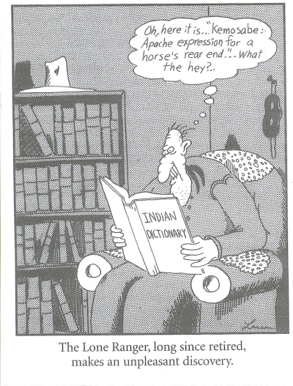
Logos
logos

Slide 28
Logos is
. . . an appeal to logic—a means to convince an audience by use of logic or reason.
. . . the words by which inward thought is expressed. The word logic is derived from logos.

Slide 29
Logos is
In speaking Logos is often equated with “logical reasoning” or “an argument based on reasoning.”
Is the message to the audience based on
Facts
Statistics
Evidence

Slide 30
Logos is
Or will your call-to-action lead to the desired outcome that you have promised?
Through the use of “reason” you can move an audience toward action or inaction—which one depends upon your “proof.”

Slide 31
Logos is
Logos is developed by using advanced, theoretical or abstract language.
Deductive Reasoning
Inductive Reasoning

Slide 32
Deductive Reasoning . . .
Logos is
begins with one or more premises based on deductive arguments that lead to one conclusion that is true.
Premises are:
Facts
Claims
Evidence
Proven conclusions

Slide 33
Logos is
The key to Deductive Reasoning is that if your premises are true, then your conclusion(s) must also be true.
A + B = C

Slide 34
Inductive Reasoning
Logos is
also begins with one or more premises based on deductive or logical arguments that lead to one conclusion but that conclusion may not be guaranteed to be true.
So why is this important?

Slide 35
Logos is
Deductive and Inductive reasoning are important because your audience continuously and subconsciously applies these two reasoning skills to draw a conclusion for themselves.
That conclusion can wholly depend upon what you present and can include or compete with the audiences strong emotional experiences.

Slide 36
. . . For example
Logos is
You are presenting a new weight-loss diet to your audience.
The new diet reduces hunger (premise A)
Reducing hunger will reduce caloric intake (premise B)
The new diet will cause weight loss (premise C)

Slide 37
Now. . . what is your audience thinking?
Logos is
Every diet I have tried has failed miserably (premise D)
This new diet is similar to those failed diets (premise E)
Therefore this new diet will also fail, miserably (premise F)

Slide 38
Deductive and Inductive Reasoning
Logos is
In this scenario your are competing with the audience’s strong emotional experiences (pathos). Since your audience has to resolve these feelings of failure, it is up to you to provide an argument that shows this diet will be different than the others.

Slide 39
How is this accomplished?
Logos is
It is difficult for a speaker to compete against a lifetime of beliefs and premises that have been previously formed by individual audience members. So . . .
The answer is to use “commonplaces.”

Slide 40
Commonplaces are . . .
Logos is
beliefs which represent shared wisdom and are widely held by groups of people.
Family members
Organizations
Society in general

Slide 41
. . . in Media
Logos
Logos is also often used as a “subliminal” element to emulate or compete with facts that may not at first be apparent. Media accomplishes this task through . . .
Using reverse imagery
Using letters to form an image
Using symbols to represent meaning

Slide 42
Logos

Slide 43
“The Economic Outlook and Monetary Policy”
Logos Example
However, although private final demand, output, and employment have indeed been growing for more than a year, the pace of that growth recently appears somewhat less vigorous than we expected. Notably, since stabilizing in mid-2009, real household spending in the United States has grown in the range of 1 to 2 percent at annual rates, a relatively modest pace. Households' caution is understandable. Importantly, the painfully slow recovery in the labor market has restrained growth in labor income, raised uncertainty about job security and prospects, and damped confidence. Also, although consumer credit shows some signs of thawing, responses to our Senior Loan Officer Opinion Survey on Bank Lending Practices suggest that lending standards to households generally remain tight.
Ben Bernanke
August 27, 2010

Slide 44
“A Generational Challenge to Repower America”
Logos Example
Two major studies from military intelligence experts have warned our leaders about the dangerous national security implications of the climate crisis, including the possibility of hundreds of millions of climate refugees destabilizing nations around the world. Just two days ago, 27 senior statesmen and retired military leaders warned of the national security threat from an “energy tsunami” that would be triggered by a loss of our access to foreign oil. Meanwhile, the war in Iraq continues, and now the war in Afghanistan appears to be getting worse.
Al Gore
July 17, 2008

Slide 45
“Is Apple Becoming a Value Stock”
Logos Example
Apple has come down from $363 in February to $316 Monday. Furthermore, that masks the fact that the company is sitting on a ton of net cash. At the end of the last quarter, cash, securities and other liquid assets exceeded liabilities by $51 billion, or around $55 a share. This may top $60 by the end of this quarter.
So the cash-free stock price — the enterprise value of the business — may only be around $260.
That’s barely 10 times forecast earnings of $25 for the fiscal year ending in September. It’s just nine times next year’s forecast earnings. And it’s only around 2.3 times this year’s sales.
Brent Arrends
July 17, 2008

Slide 46
Ethos, Pathos, Logos

Slide 47
Ethos, Pathos, Logos
Although we have looked at Ethos, Pathos, and Logos used as separate elements, they rarely are independent of each other. Contrary to what has been presented as examples, the three bodies work together to persuade audiences to form opinions and/or move to action. Next is an example of how Ethos, Pathos, and Logos work together in George W. Bush’s “Presidential Nomination Acceptance Speech.”
Ethos elements are in blue
Pathos elements are in brown
Logos elements are in pink

Slide 48
Ethos, Pathos, Legos
Ethos, Pathos, Logos
Nomination Acceptance Address By George W. Bush August 18, 1988
My friends, eight years ago this economy was flat on its back -- intensive care. We came in and gave it emergency treatment: Got the temperature down by lowering regulation, got the blood pressure down when we lowered taxes. Pretty soon the patient was up, back on his feet, and stronger than ever.
And now who do we hear knocking on the door but the doctors who made him sick. And they're telling us to put them in charge of the case again. My friends, they're lucky we don't hit them with a malpractice suit!
We've created seventeen million new jobs in the past five years -- more than twice as many as Europe and Japan combined. And they're good jobs. The majority of them created in the past six years paid an average of more than $22,000 a year. Someone better take 'a message to Michael': Tell him we've been creating good jobs at good wages. The fact is, they talk -- we deliver. They promise -- we perform.
There are millions of young Americans in their 20's who barely remember the days of gas lines and unemployment lines. Now they're marrying and starting careers. To those young people I say " You have the opportunity you deserve -- and I'm not going to let them take it away from you."
There are millions of older Americans who were brutalized by inflation. We arrested it -- and we're not going to let it out on furlough. We're going to keep the social security trust fund sound, and out of reach of the big spenders. To America's elderly I say, "Once again you have the security that is your right -- and I'm not going to let them take it away from you."
I know the liberal democrats are worried about the economy. They're worried it's going to remain strong. And they're right, it is. With the right leadership. But let's be frank. Things aren't perfect in this country. There are people who haven't tasted the fruits of the expansion. I've talked to farmers about the bills they can't pay. I've been to the factories that feel the strain of change. I've seen the urban children who play amidst the shattered glass and shattered lives. And there are the homeless. And you know, it doesn't do any good to debate endlessly which policy mistake of the '70's is responsible. They're there. We have to help them.

Slide 49
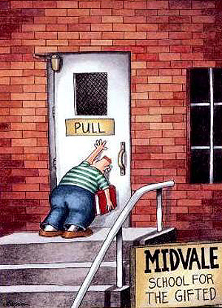
War is not a Computer Game

