Slide 1
Vocabulary 1

Slide 2
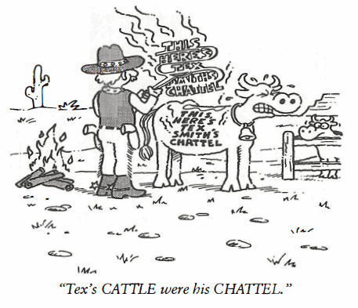
Chattel (N)
The bank held a CHATTEL mortgage on all our office equipment, chairs computers and even our electric clock.

Slide 3
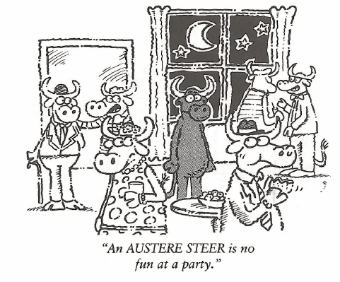
Austere (Adj)
The AUSTERITY of life in the village was understandable. Many were jobless and evidence of poverty was everywhere.

Slide 4
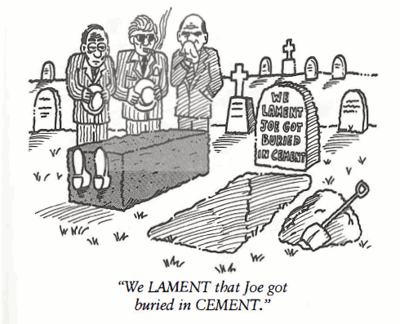
Lament (N)
It is LAMENTABLE that Roscoe quit college in his sophomore year; his professors considered him the brightest engineering student in his class.

Slide 5
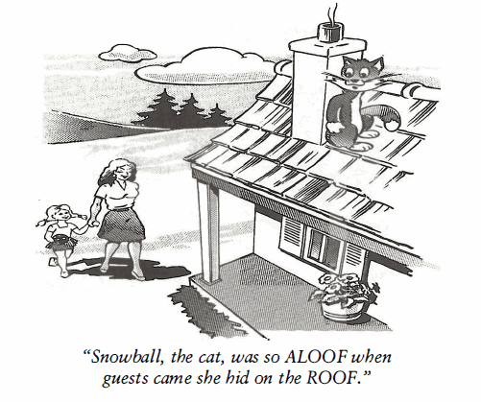
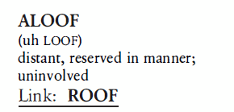
Aloof (Adj)
Nothing ruins a fine dinner at a good restaurant like an ALOOF waiter who makes the entire experience uncomfortable.

Slide 6
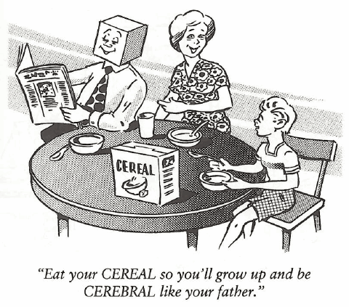
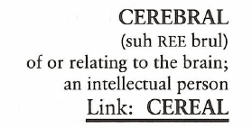
Cerebral (Adj)
Dr. Clark was too CEREBRAL to be a Boy Scout leader. Instead of saying “Pitch your tents over by the cliff,” he would confuse everyone with his big words and say, “Construct the canvas shelters in the proximity of the promontory.”

Slide 7
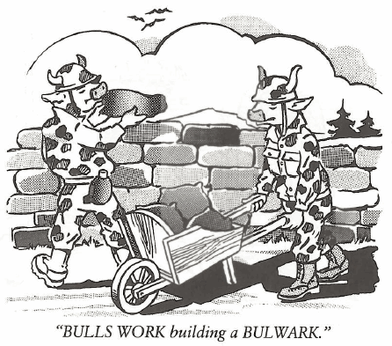
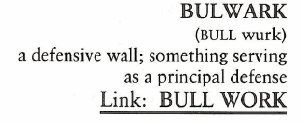
Bulwark (N)
The budget for national defense is an economic burden for all tax payers, but we must never forget our armed services are the BULWARK of defense for the nation.

Slide 8
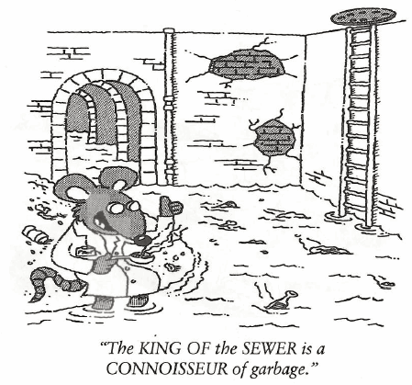
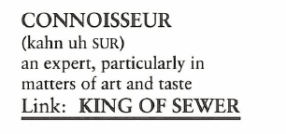
Connoisseur (N)
“What makes you a CONNOISSEUR of bathing suits?” one Eskimo asked of the other.

Slide 9
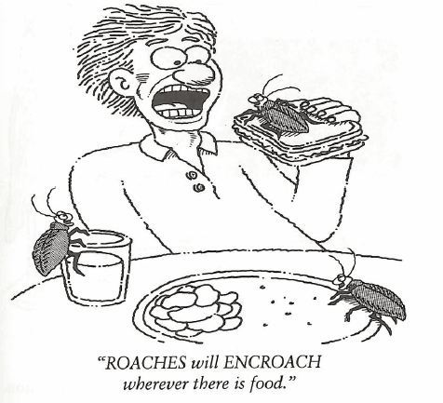
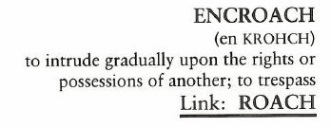
Encroach (V)
With an ENCROACHING anxiety bordering on hysteria, I made my way down the shoulder of the deep ditch to where the crashed car lay on its side.

Slide 10
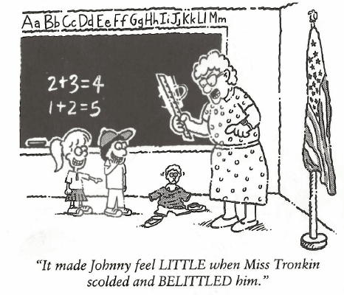
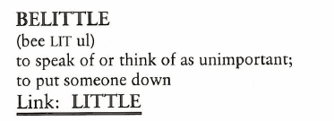
Belittle (V)
It’s not fair to BELITTLE someone’s opinion when you aren’t sure of all the facts applied to their decision-making process.

Slide 11
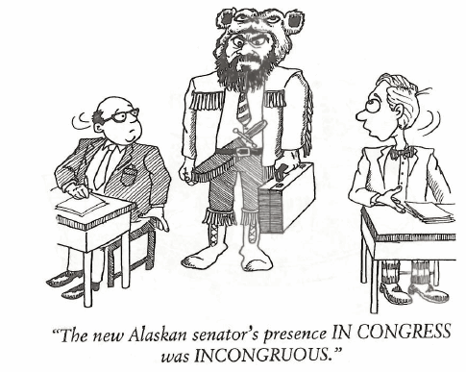
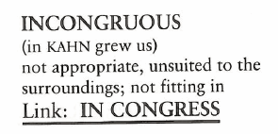
Incongruous (Adj)
INCONGRUOUSLY, Natalie spent several days a week at the library, even though she professed she didn’t like to read.

