Slide 1
Vocabulary 10

Slide 2
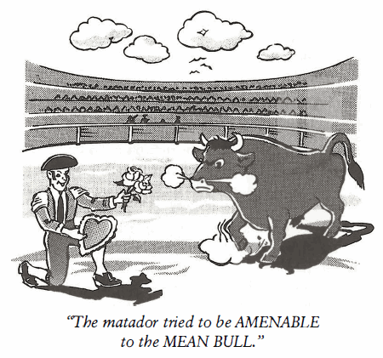
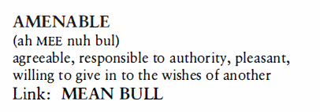
Amenable (Adj)
To raise money for the softball team, the Seminole Indians were AMENABLE to sharing the revenue from the games at their bingo hall.

Slide 3
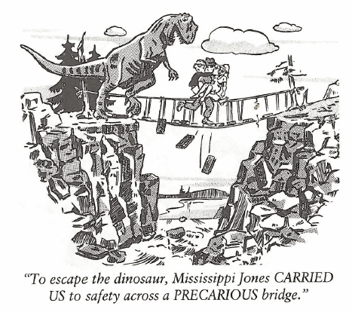
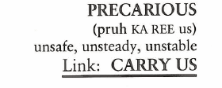
Precarious (Adj)
The PRECARIOUSNESS of the situation did not fully strike the fishermen until their small boat arrived at the dock only moments before the storm struck.

Slide 4
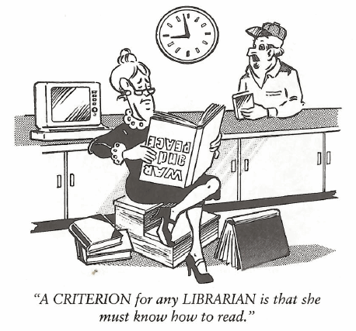
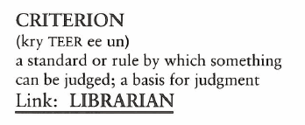
Criterion (N)
(CRITERION is singular, while CRITERIA is plural.) The physical CRITERIA for a good basketball player are to be seven feet tall and jump like a kangaroo.

Slide 5
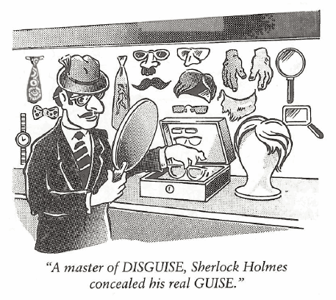
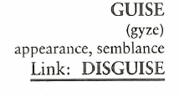
Guise (N)
(A false appearance can also be a GUISE.) Amy was extremely cautious of advances made toward her by Sam because, as she put it, he had the GUISE of an angel, but she didn’t trust his motives.

Slide 6
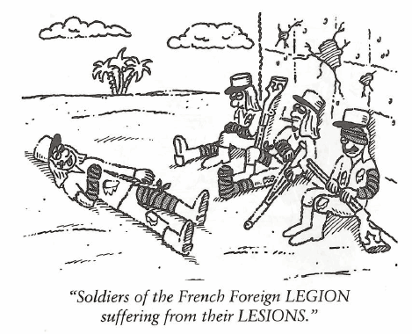
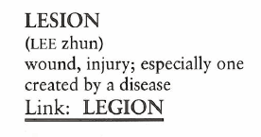
Lesion (N)
The nurses told Crystal to keep the bandage on her knee until the LESION healed, otherwise the open sore would be prone to infection by air-borne bacteria.

Slide 7
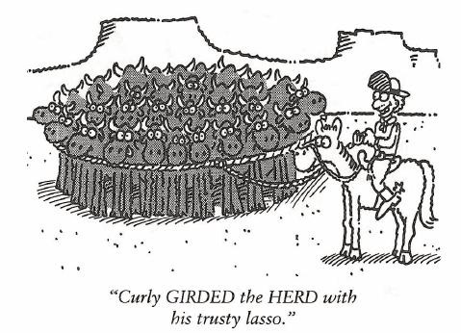
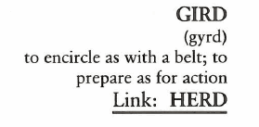
Gird (V)
Jack hoped he could stop the invasion of weeds from his neighbor’s yard by GIRDING his lawn with a pre-emergent herbicide.

Slide 8
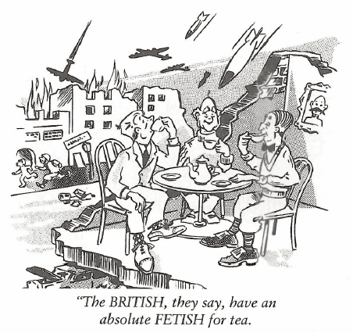
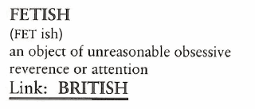
Fetish (N)
Her psychologist said the reason Darlene had a FETISH of washing her hands a dozen times a day was because she had a guilt complex about something in her past, and she was trying to wash the guilt away.

Slide 9
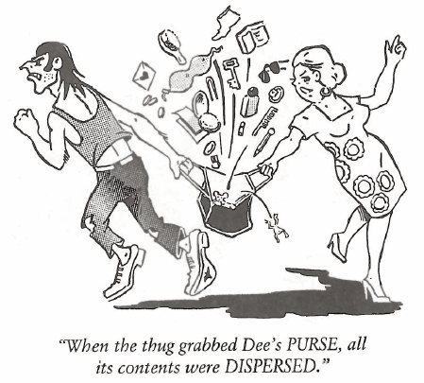
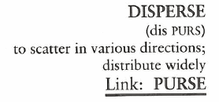
Disperse (V, Adj)
Bonaparte DISPERSED his troops strategically all along the mountain’s ridge where they could fire down upon the Austrian Army as it advanced up the hill.

Slide 10
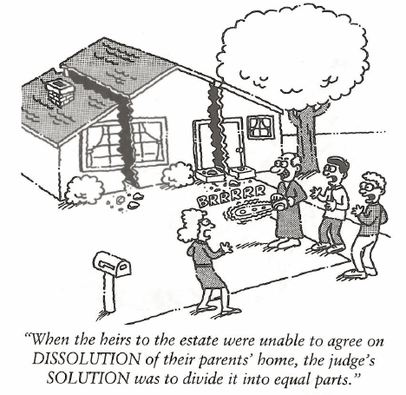
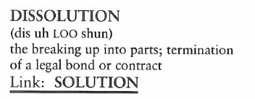
Dissolution (N)
After his wife’s death, Bill fell into a DISSOLUTE lifestyle, caring little for his appearance or career.

Slide 11
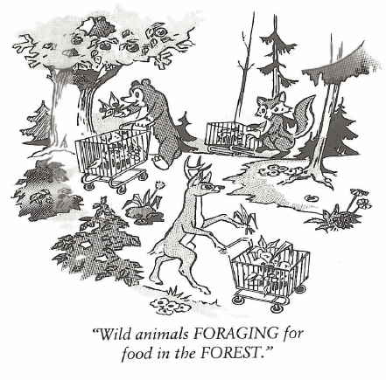
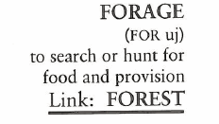
Forage (V, N)
We FORAGED through the shed for plywood, tin sheets, and boards; anything with which to board up the windows and doors before the full force of the hurricane struck.

