Slide 1
Vocabulary 11

Slide 2
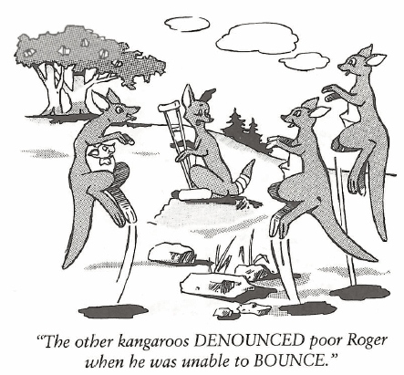
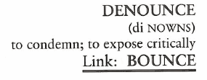
Denounce (V)
As an act of conscience, the young thief DENOUNCED his fellow thieves and confessed their criminal acts to the police.

Slide 3
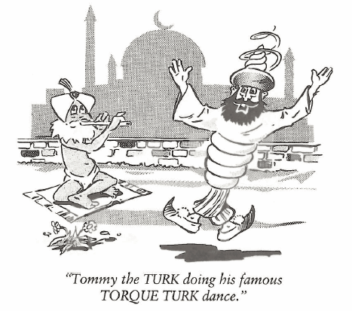
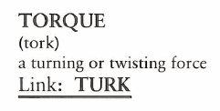
Torque (N, V)
We all took our turn, but none of my brothers or I could apply enough TORQUE to open the jar of strawberry jam.

Slide 4
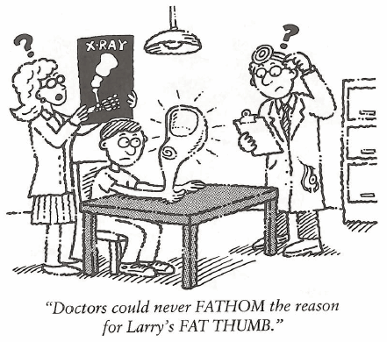
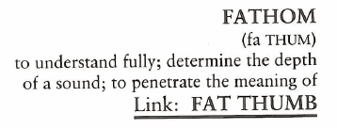
Fathom (N, V)
(In nautical terms, FATHOM is six feet of water depth.) We dropped anchor in four FATHOMS of water and made plans to stay for the night.

Slide 5
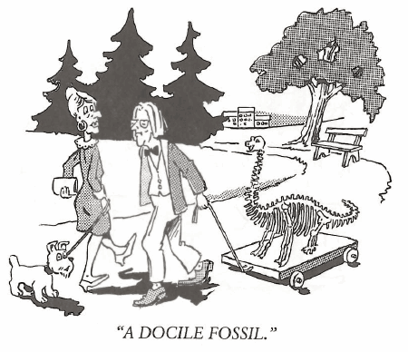
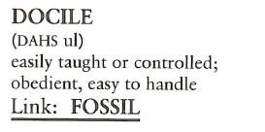
Docile (Adj)
Cameron was a fierce competitor on the football field, but his wife said he was a sweet, DOCILE husband.

Slide 6
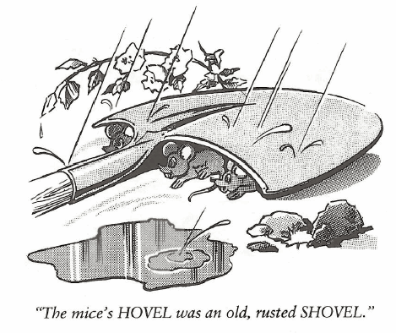
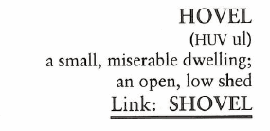
Hovel (N)
Compared to the Summertons’ palatial estate on Long Island, Jane said her apartment in the Bronx was a HOVEL.

Slide 7
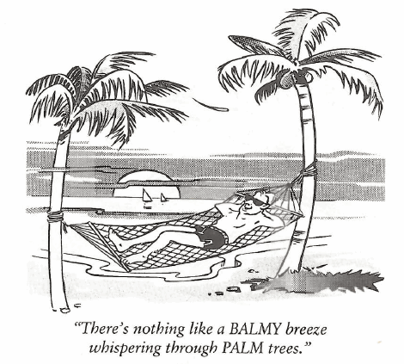
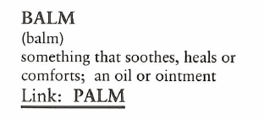
Balm (N)
It was a BALMY day, perfect for a game of golf or a trip to the beach.

Slide 8
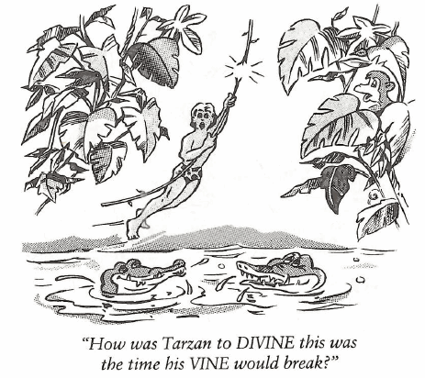
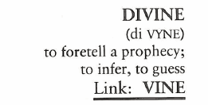
Divine (Adj, N)
(DIVINE also means supremely pleasing.) It was a DIVINE party, and a great time was had by all.

Slide 9
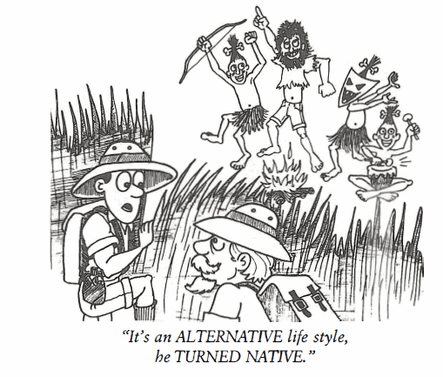
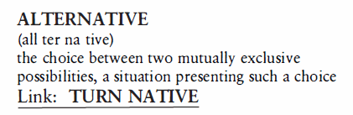
Alternative (Adj, N)
The ALTERNATIVE to playing in the band was to try out for the tennis team.

Slide 10
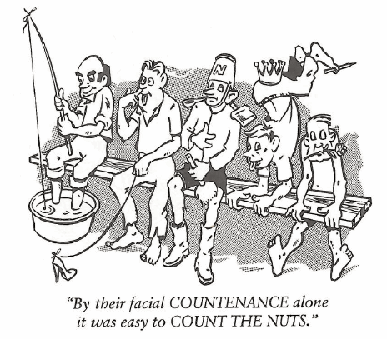
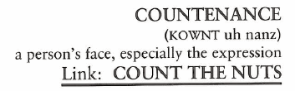
Countenance (N, V)
(To COUNTENANCE something is to tolerate or approve of it.) The coach COUNTENANCED the players’ horse play, even though he didn’t approve of it.

Slide 11
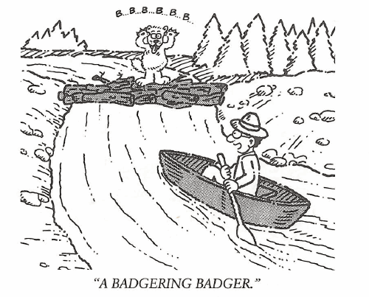
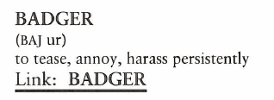
Badger (N, V)
“Don’t BADGER me,” Mark said to his coach. “I promised I’d learn the plays, so please be patient until I finish my ice cream cone.”

