Slide 1
Vocabulary 12

Slide 2
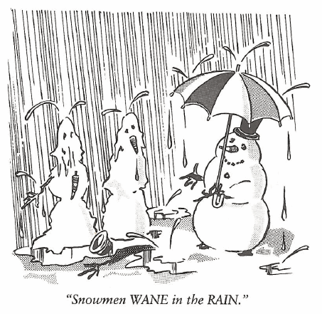
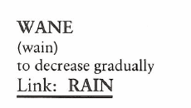
Wane (V)
Marilyn’s interest in a new beau began to WANE when she discovered Jack had invited three other girls as his date for the junior prom.

Slide 3
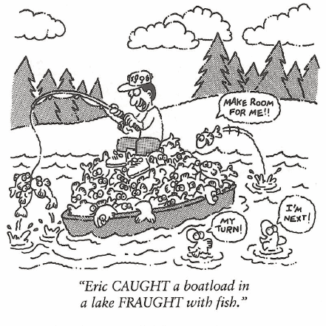
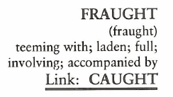
Fraught (Adj)
Although Mark Twain’s books were FRAUGHT with humor, they nevertheless drove home good advice for their readers, young and old.

Slide 4
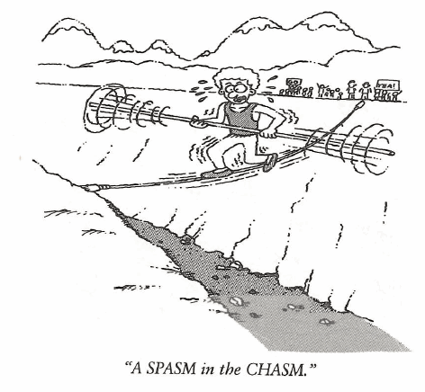
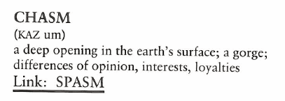
Chasm (N)
“There are CHASMS and there are CHASMS,” said the professor. “The Grand Canyon is one big CHASM, but I fear some of you have CHASMS where your noggins ought to be.

Slide 5
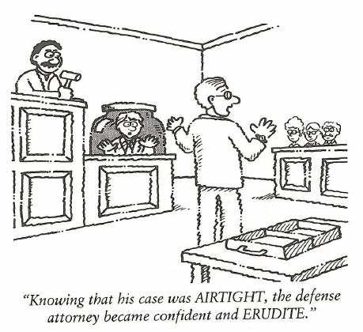
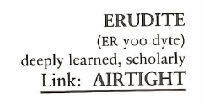
Erudite (Adj)
Most professional speakers are ERUDITE, with the understanding of proper grammatical structure and a large vocabulary at their command.

Slide 6
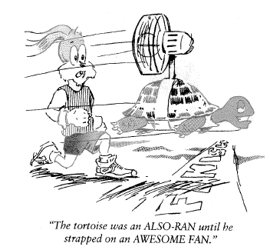
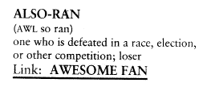
Also-ran (N)
With twenty thousand runners in the New York Marathon even if you defeat nineteen thousand nine hundred and ninety-eight, you would still be an ALSO-RAN.

Slide 7
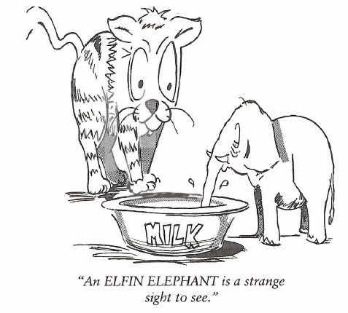
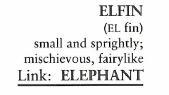
Elfin (Adj, N)
Jane is very small and has a magical ELFIN charm about her until she starts to sing. Then she sounds like a bullfrog in a pond.

Slide 8
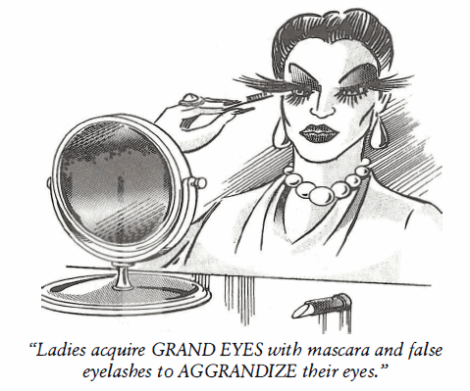
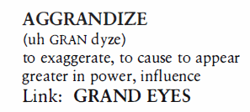
Aggrandize (V)
George was the principal AGGRANDIZER of his own achievements, making the little ones bigger and the bigger ones unbelievable. He was self-AGGRANDIZING to the point where his boastfulness created a negative impression.

Slide 9
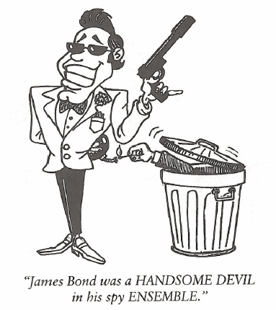
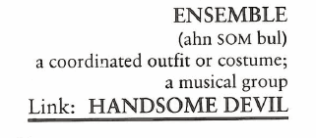
Ensemble (N)
A French fashion designer will work an entire year to get ready to show his ENSEMBLES.

Slide 10
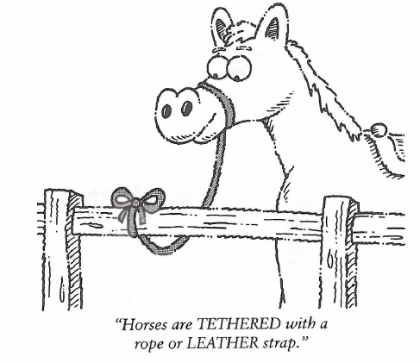
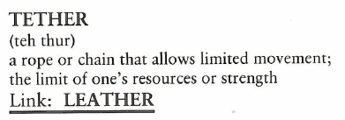
Tether (V, N)
Norman told the guys that he had enough money to go camping, but we knew it was because his boss had him TETHERED to a desk and wouldn’t let him go.

Slide 11
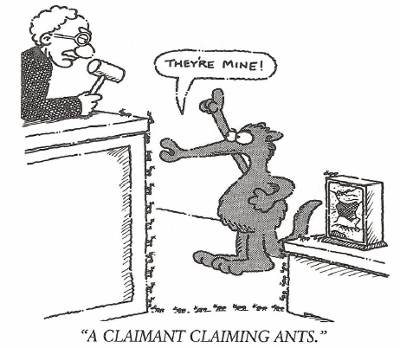
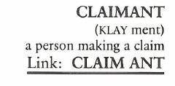
Claimant (N)
Rosalie not only wanted the house in her divorce from Robert, but she was also the CLAIMANT of his doll collection.

