Slide 1
Vocabulary 13

Slide 2
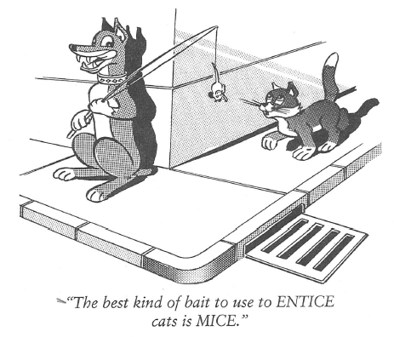
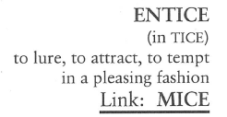
Entice (V)
Your job proposal in Michigan is ENTICING, but my family likes it here in Palm Beach; Michigan’s winters are too cold for native Floridians like us.

Slide 3
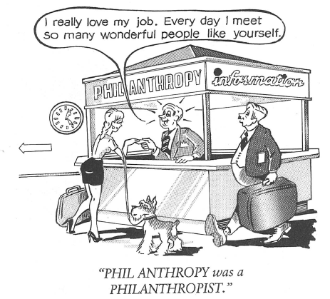
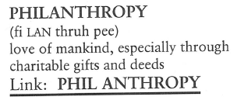
Philanthropy (N)
In the movie, Good Sam, Gary Cooper’s character was so PHILANTHROPIC, giving to anyone in need and keeping so little for his own family, he soon had nothing left.

Slide 4
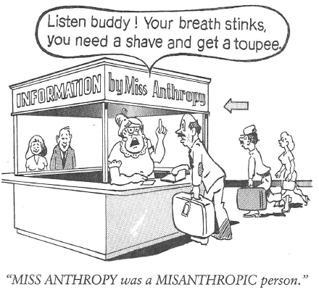
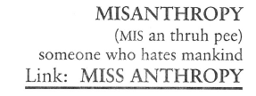
Misanthropy (N)
Some people live their entire lives never realizing they have a MISANTHROPIC attitude about the world, because first and foremost they have never liked themselves.

Slide 5
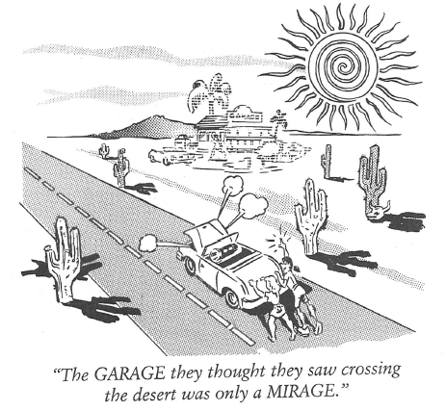
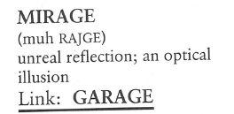
Mirage (N)
The MIRAGE of the lake was a welcome sight to the parched desert traveler until he bent down to take a drink and got a mouthful of sand.

Slide 6
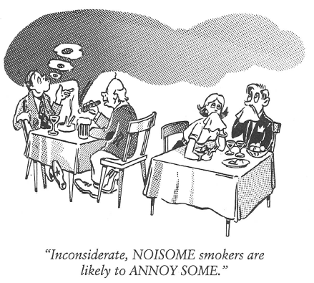
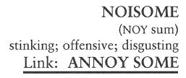
Noisome (Adj)
The comedian’s act was absolutely NOISOME; all of his jokes depended entirely on four-lettered vulgarities.

Slide 7
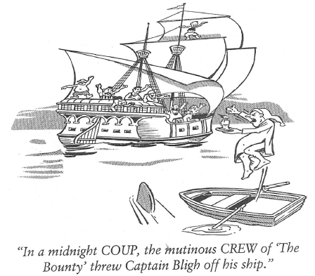
Coup (N)
It was a real COUP for James when his teammates elected him captain of the basket weaving team.

Slide 8
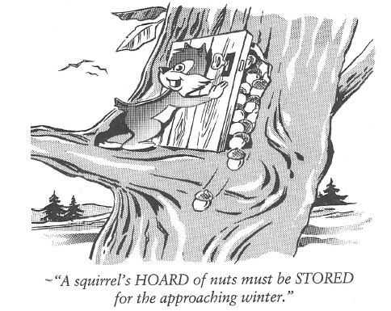
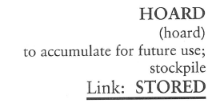
Hoard (V)
We told Ed there was no point in his HOARDING all the cake; he might as well share with us before it spoiled.

Slide 9
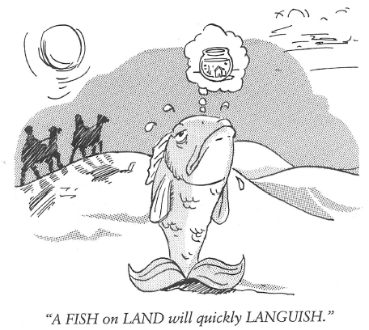
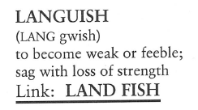
Languish (V)
(To LANGUISH is to be LANGUID.) The fish in the aquarium hardly stirred, moving LANGUIDLY when they moved at all.

Slide 10
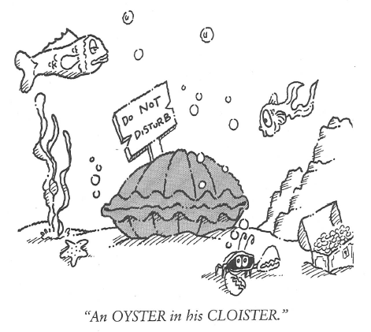
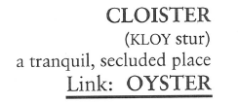
Cloister (N)
(To CLOISTER someone is to place them in a place of seclusion, although they may or may not be in the company of others.) Jim CLOISTERED himself in his hotel room for the entire week of his vacation.

Slide 11
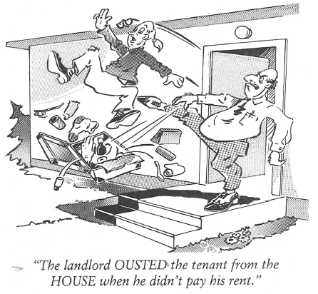
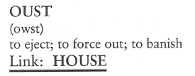
Oust (V)
The people in his part of the stands wanted to have Roger OUSTED for making too much noise during the tennis match.

