Slide 1

Vocabulary 15

Slide 2
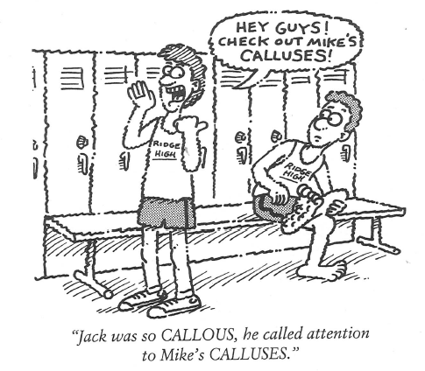
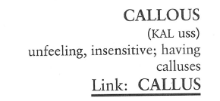
Callous (N, Adj)
It is hard to understand how in India some CALLOUS people can ride in their limousines past hoards of beggars and not pay them the slightest attention.

Slide 3
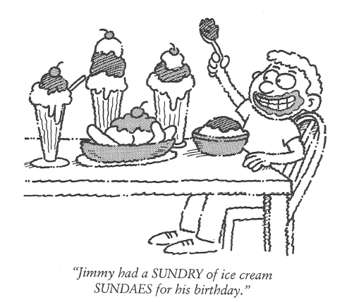
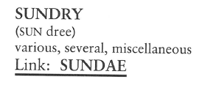
Sundry (N, adj)
A SUNDRY store is usually like a five-and-dime, a store carrying a variety of miscellaneous items for the household and personal use.

Slide 4
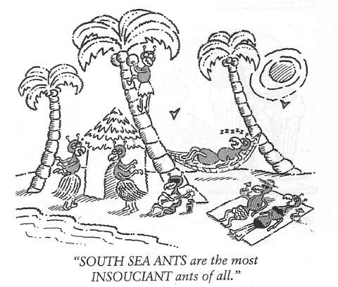
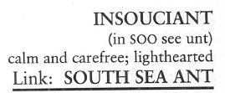
Insouciant (adj)
Her cheerful INSOUCIANCE was greatly admired by everyone in her office, but her husband says to wake up to such cheerfulness before he has had a cup of coffee is driving him up a wall.

Slide 5
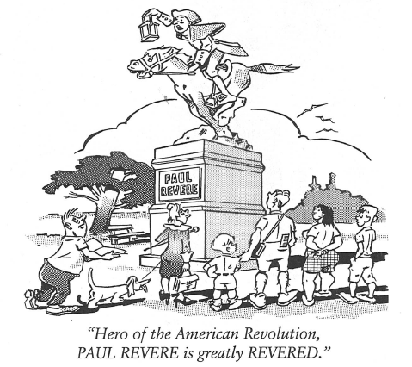
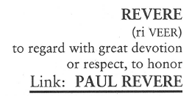
revere (v)
Another who enjoyed almost universal recognition and REVERANCE for his humanitarianism in the medical field was Dr. Schweitzer.

Slide 6
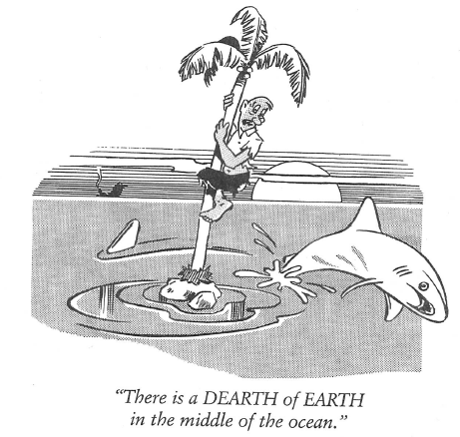
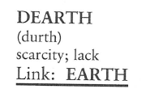
dearth (N)
This Broadway season was the poorest in years. Critics say this was largely due to a DEARTH of good playwrights.

Slide 7
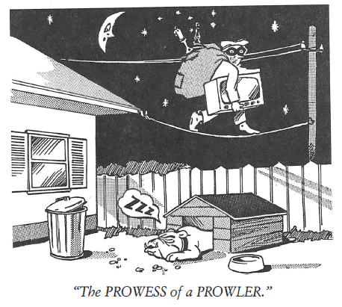
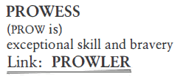
prowess (n)
Rod Laver’s PROWESS as the world’s best tennis player is supported by the fact, he won the Grand Slam twice. This has not been done since.

Slide 8
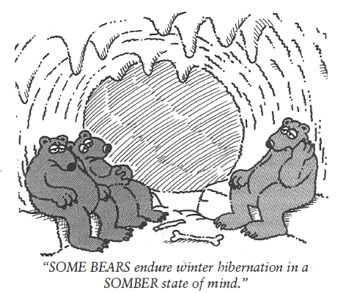

somber (adj)
Martin had the most SOMBER expression, and there was nothing we could do to cheer him up. Hardly what one might expect from a man getting married the next day.

Slide 9
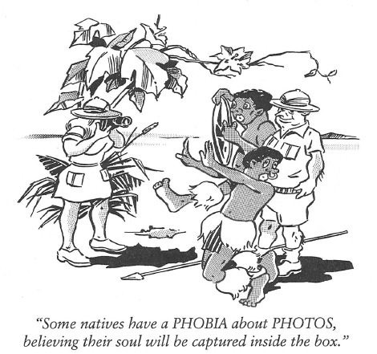
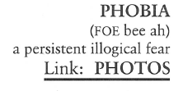
Phobia (N)
Claustrophobia is the PHOBIA of a person who fears small, confined spaces.

Slide 10
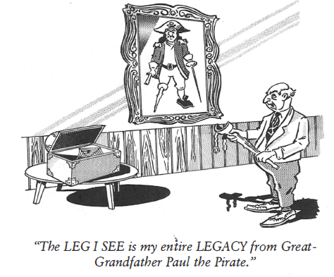
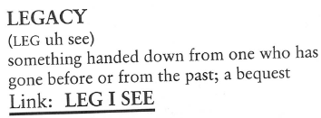
Legacy (N)
In the late 1800s, the fictional LEGACIES of the Old West were of cowboys riding from town-to-town shooting at each other.

Slide 11
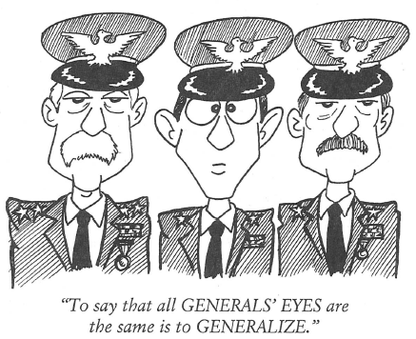
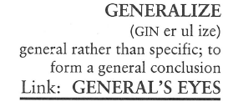
generalize (adj)
Our teacher asked us to be specific in our essay criticisms and avoid GENERALIZATIONS.

