Slide 1
Vocabulary 16

Slide 2
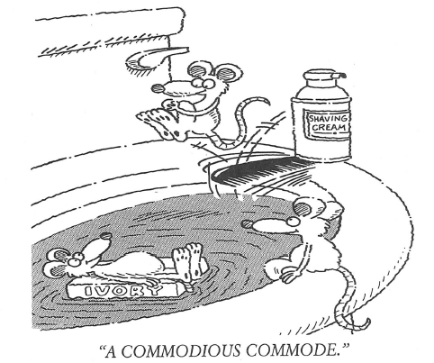
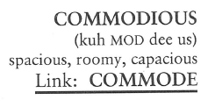
Commodious (Adj)
In Hong Kong, the government has built several million apartments for the working class in recent decades. When compared to western standards, they are not very COMMODIOUS, only about half the size of a small, two-bedroom apartment in the United States.

Slide 3
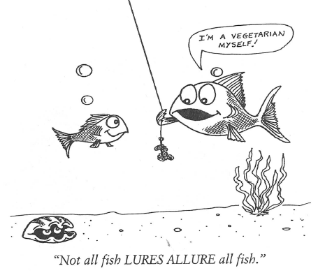
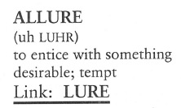
Allure (V)
The ballet dancer’s perfume was so ALLURING grown men fainted when she danced past.

Slide 4
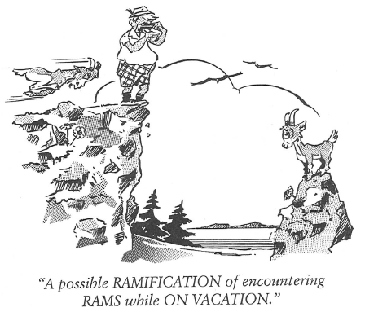
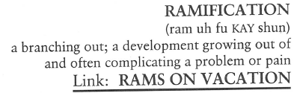
Ramifications (N)
A RAMIFICATION is a development or consequence growing from the main body as limbs grow from trees and plants; therefore, there are RAMIFICATIONS to every act a person makes no matter how small, because every act has a consequence.

Slide 5
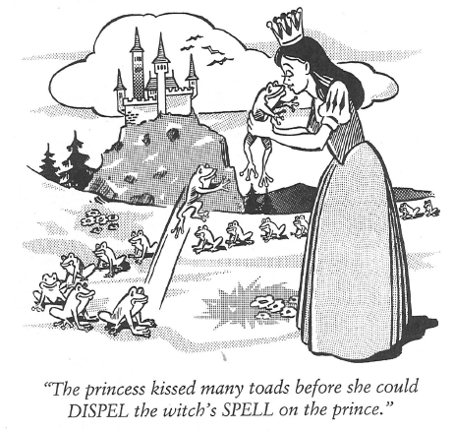
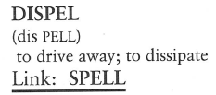
Dispel (V)
After the crowd had been DISPELLED from the scene of the accident, the wreckers hauled away the tangled, wrecked automobiles.

Slide 6
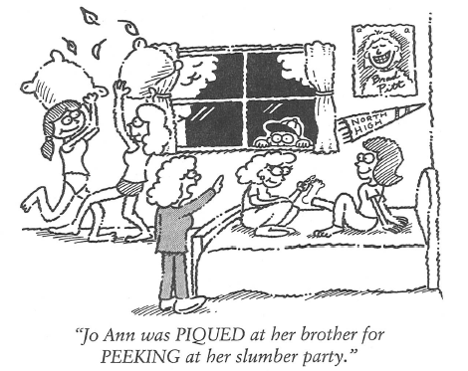
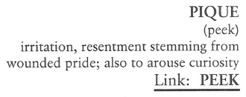
Pique (V, N)
Joey said he was PIQUED at the chemistry teacher for giving out final grades before he had time to finish his lab work.

Slide 7
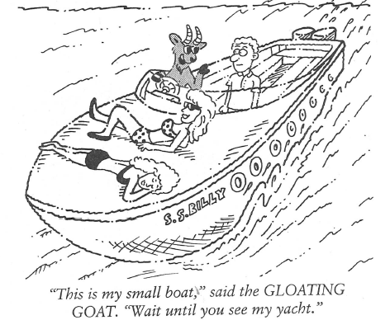
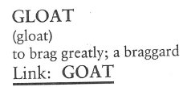
Gloat (V, N)
The mechanic said he didn’t want to appear to GLOAT, but he did warn his customer last year they would have to fix the car now or fix it later, and later would cost more.

Slide 8
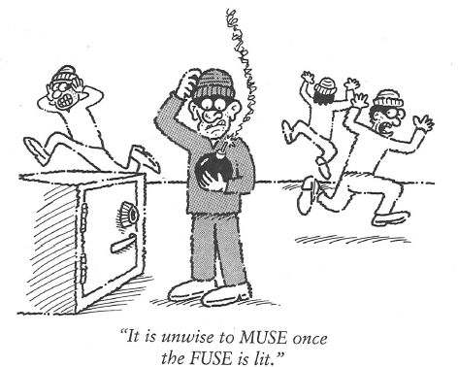
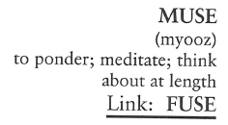
Muse (V)
Chess is a MUSING game of skill whereupon each player MUSES over all the possible moves before deciding which piece to move.

Slide 9
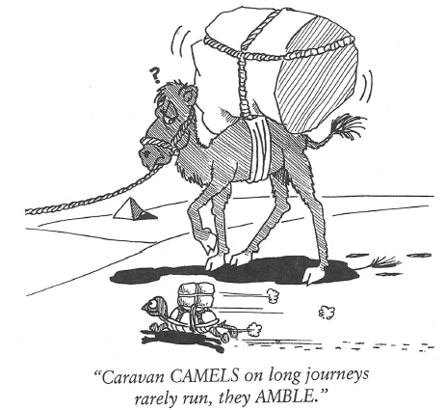
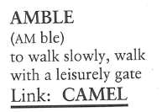
Amble (V, N)
“AMBLE on out here,” the dance instructor said to the new student. “Let’s see some of your moves.”

Slide 10
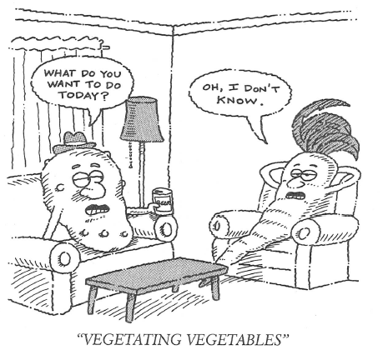
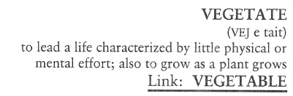
Vegetate (V)
A Rhodes scholar in his youth, Rick Farrell took a job on an assembly line in an automobile plant and let his mind VEGETATE.

Slide 11
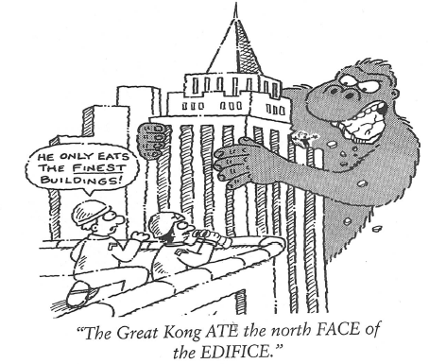
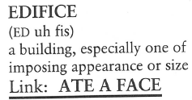
Edifice (N)
Neither imposing in appearance or size, you could hardly refer to an outhouse as an EDIFICE.

