Slide 1
Vocabulary 17

Slide 2
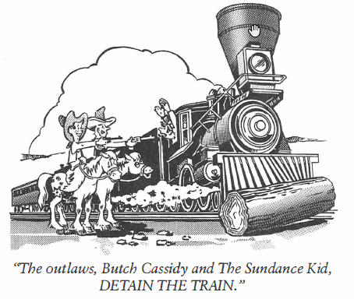
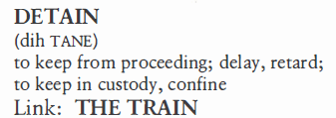
Detain (V)
Our ship was DETAINED for three months in the Panama Canal because it had struck a piling and developed a leak in the hull.

Slide 3
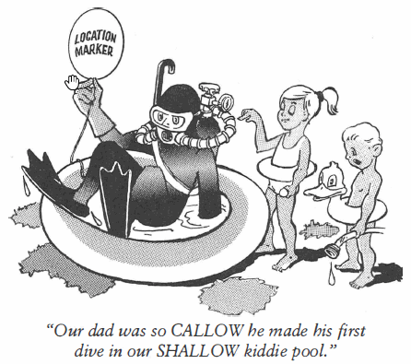

Callow (Adj)
When General Troister saw the CALLOW appearance of his troops during inspection, he reminded himself wars kill the youth of the nation, not the old politicians who start them.

Slide 4
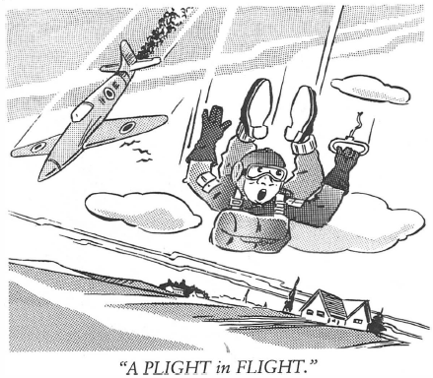
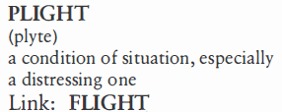
Plight (N)
Determined to rescue the fifty hostages from their PLIGHT, the police rushed the aircraft before the terrorists could cause further harm.

Slide 5
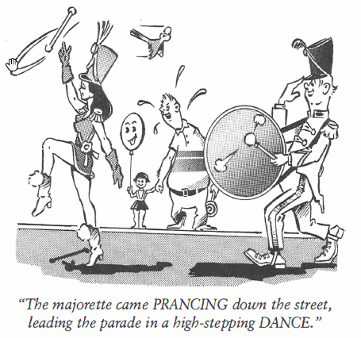
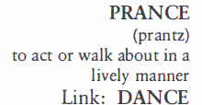
Prance (V, N)
Rodney was a real showboat; every time he made a touchdown he PRANCED about as if he thought he was “hot stuff.”

Slide 6
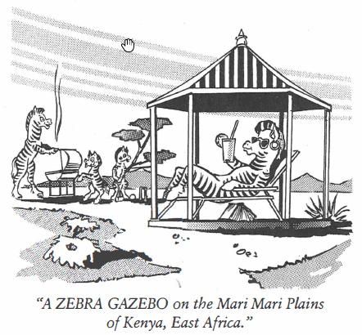
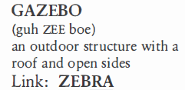
Gazebo (N)
The GAZEBO in the mission courtyard was used for weddings in the summer. In the winter, goats would come and huddle together to stay warm and out of the rainy weather.

Slide 7
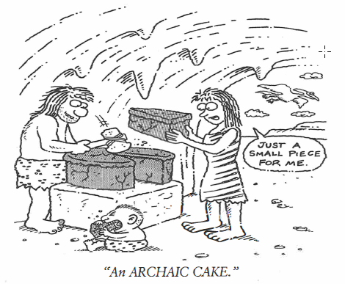
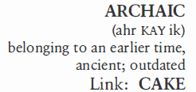
Archaic (Adj)
ARCHAIC civilizations, those which are not around anymore, are the chief subject of archaeological studies.

Slide 8
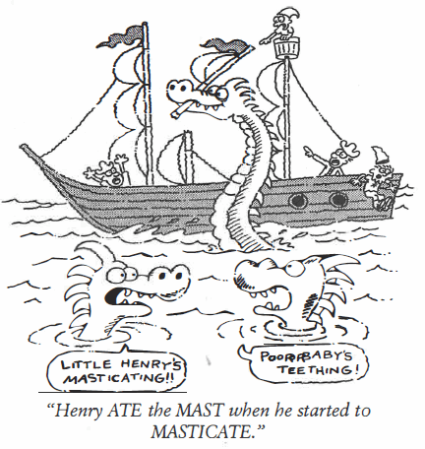

Masticate (V)
Almost all birds MASTICATE food before giving it to their young.

Slide 9
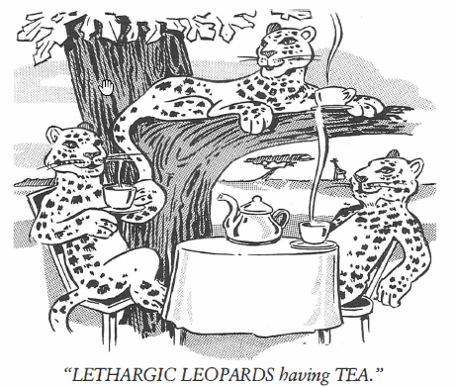

Lethargy (N, Adj)
There is nothing LETHARGIC about Cheetah chasing prey, as cheetahs are the fastest animals on earth.

Slide 10
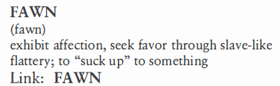
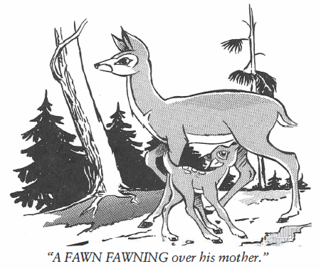
Fawn (V, N)
Mr. Johnson was a professional at “sucking up” to everybody he thought could help him advance in his career, a pro-fessional FAWNER from the word go.

Slide 11
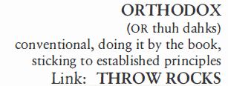
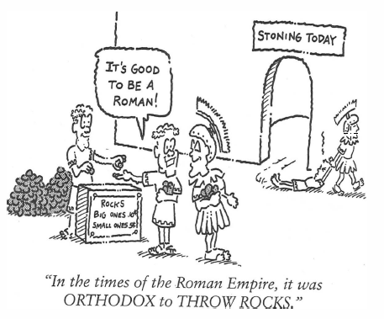
Orthodox (Adj)
An ORTHODOX religion is one holding fast to unchanging historical views.

