Slide 1
Vocabulary 2

Slide 2
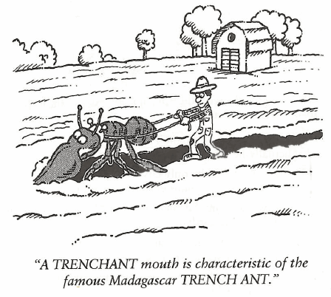
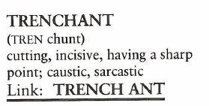
Trenchant (Adj)
Julie had a TRENCHANT tongue and was always putting her friends down behind their backs.

Slide 3
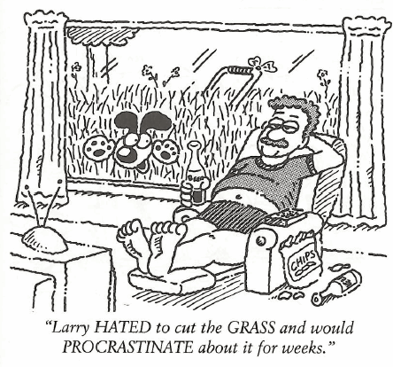
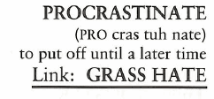
Procrastinate (V)
After failing the test, the teacher asked the student if he had studied for the test. The student replied, “Never do today what you can PROCRASTINATE until tomorrow.”

Slide 4
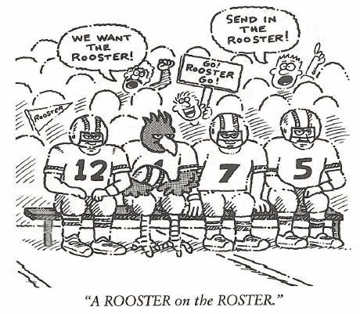
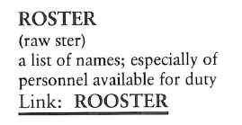
Roster (N)
The military is full of all types of ROSTERS; there is a duty ROSTER, a leave ROSTER and even a ROSTER for latrine duty.

Slide 5
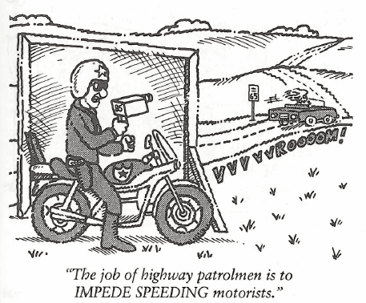
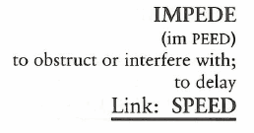
Impede (V)
(Something that IMPEDES is an IMPEDEMENT.) As a hopeful runner on the school track team, James Carver’s biggest IMPEDIMENT to his foot speed was his short legs.

Slide 6
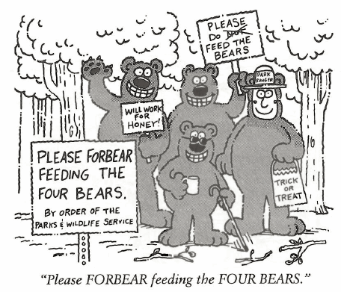
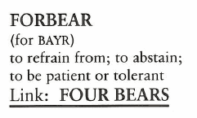
Forbear (V)
Jonathan said his motto was to never FORBEAR a good party for another time when you can have one today.

Slide 7
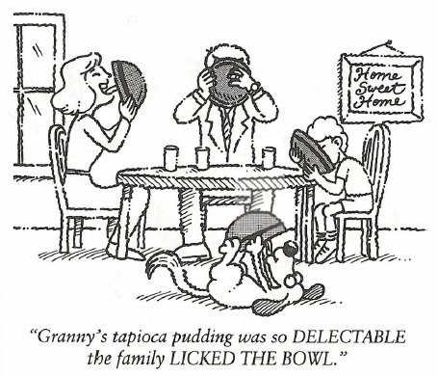
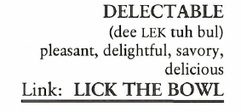
Delectable (Adj)
All the frozen dinners look DELECTABLE in the grocery store but the food is not ever as good as it looked on the package.

Slide 8
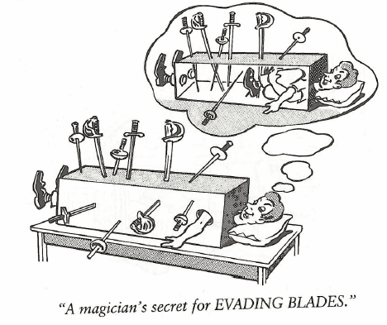
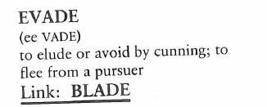
Evade (V)
Jane always managed to EVADE helping her sister wash the dinner dishes by claiming she had homework to do.

Slide 9
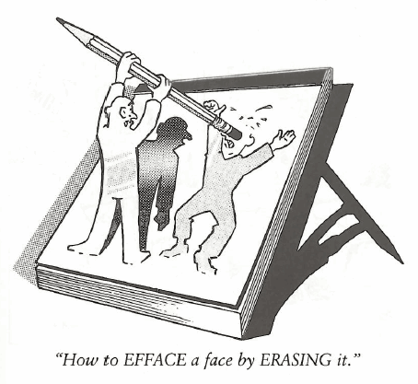
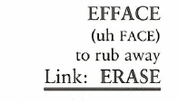
Efface (V)
To ensure he left no clues, the thief EFFACED his fingerprints from the stolen car.

Slide 10
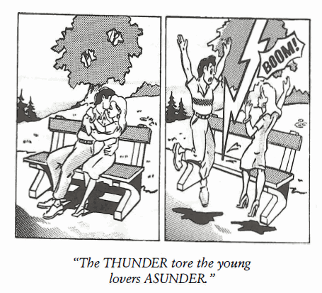
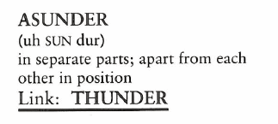
Asunder (Adv)
Our team lost its unity and became a group of individuals who played entirely for themselves, ASUNDER from each other.

Slide 11
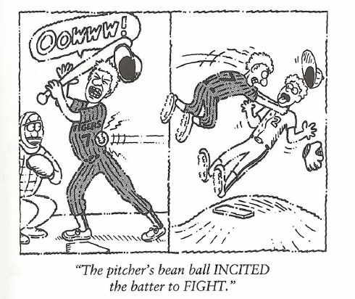
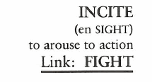
Incite (V)
Waving a stick at Jerry’s dog only INCITES him and increases the chance he will bite you.

