Slide 1
Vocabulary 27

Slide 2

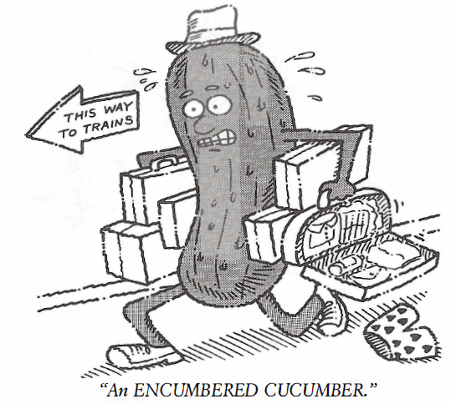
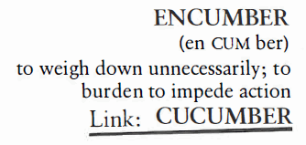
Encumber (V)
Favored to win the mile race, Stephanie came in second because she was ENCUMBERED by an ingrown toenail.

Slide 3
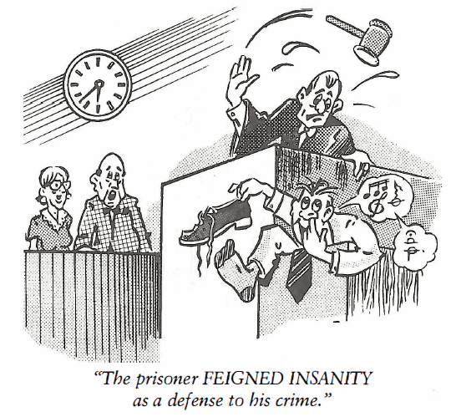
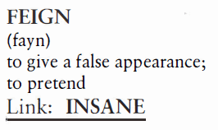
Feign (V)
Elizabeth FEIGNED illness in order to stay home from school the day of her final exam in math.

Slide 4
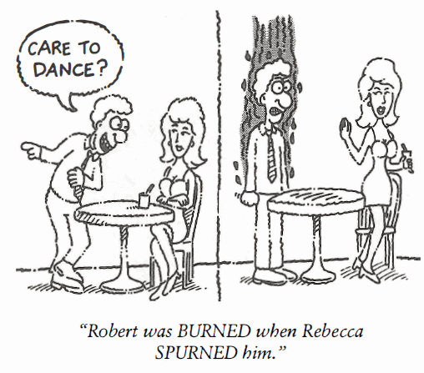
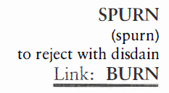
Spurn (V)
John thought he made a fair offer for the house, but the owner SPURNED his offer and actually became angry about it.

Slide 5
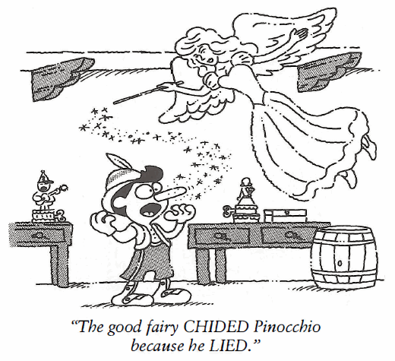
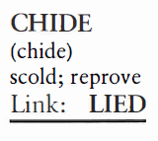
Chide (V)
I don’t mind being CHIDED for things I did, but I hate being CHIDED for what my sneaky sister Elizabeth did.

Slide 6
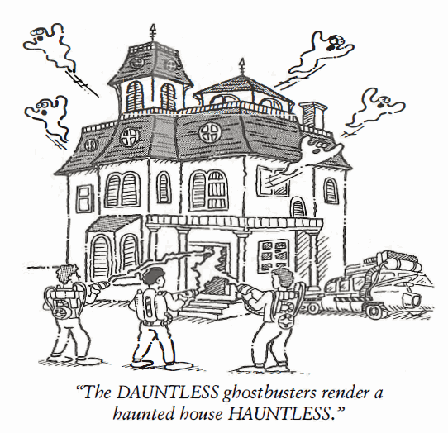
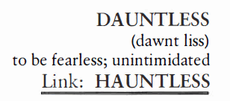
Dauntless (Adj)
The hikers were UNDAUNTED by the steepness of the mountain; however, they decided to turn back for the sake of their own safety.

Slide 7
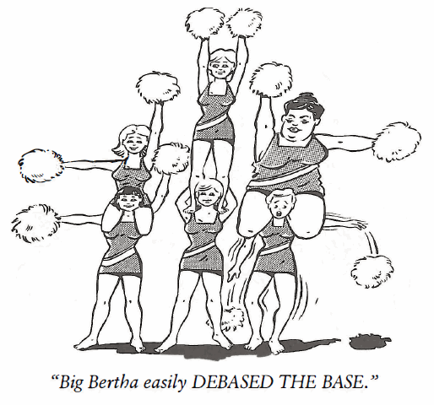
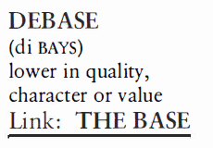
Debase (V)
The judge sued the newspaper for DEBASING his character in an article claiming he was too easy on criminals.

Slide 8
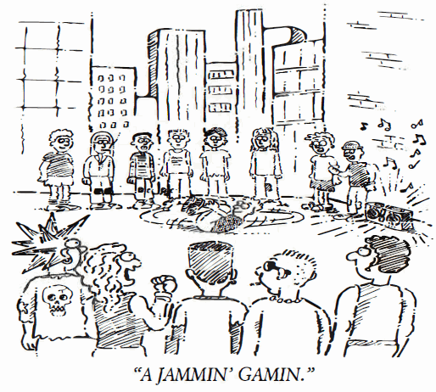
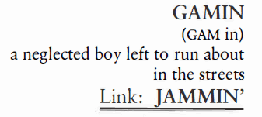
Gamin (N)
In the novel, Oliver Twist, we learn of the intolerable living conditions in English orphanages of the nineteenth century and the life of the many homeless, streetwise GAMINS.

Slide 9
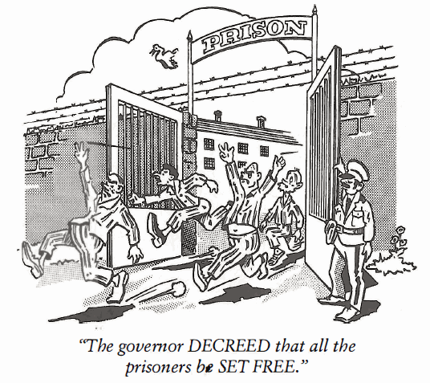
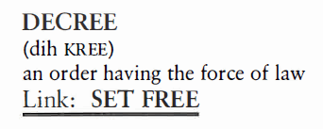
Decree (N)
In Dodge City, during the days of the great cattle drives of the 1880s, Sheriff Wyatt Earp enforced the DECREE that all guns must be turned over to the sheriff’s deputy before anyone could ride into town.

Slide 10
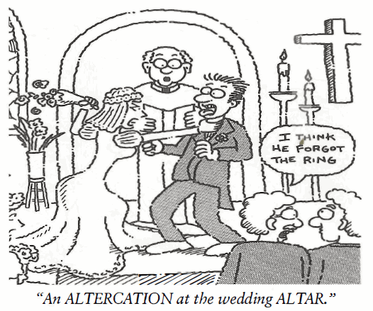
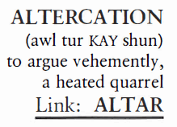
Altercation (N)
The Sioux Indians were not looking for an ALTERCATION, but when General Custer’s men attacked their village, the Sioux wiped out Custer and his troops in self-defense.

Slide 11
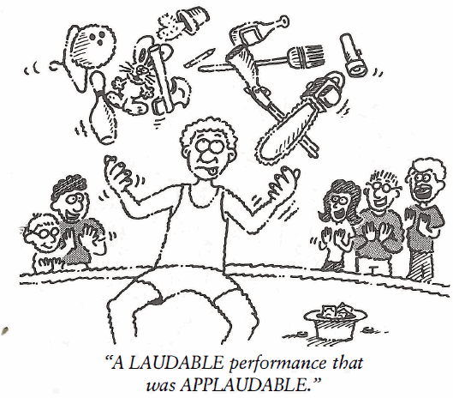
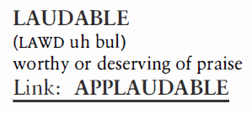
Laudable (Adj)
Hector’s teacher told him she thought it most LAUDABLE that he wanted to become a doctor, but an F in biology was not going to help him achieve his goal.

