Slide 1
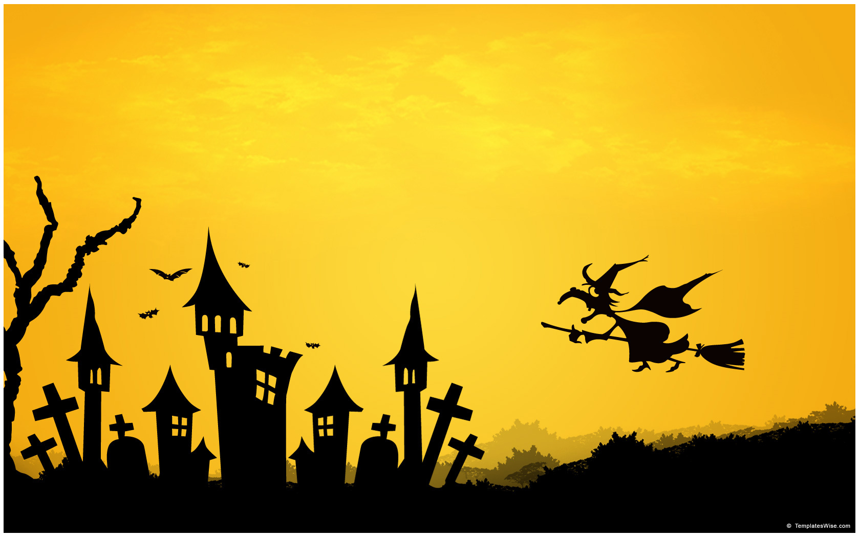
Vocabulary 4

Slide 2
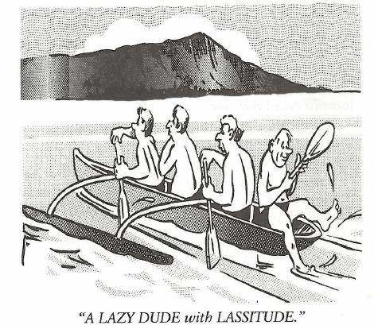
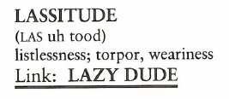
Lassitude (N)
Having worked for the cannery for twenty years without a raise, Charles became discouraged with his employers and approached his daily work with unenthusiastic LASSITUDE.

Slide 3
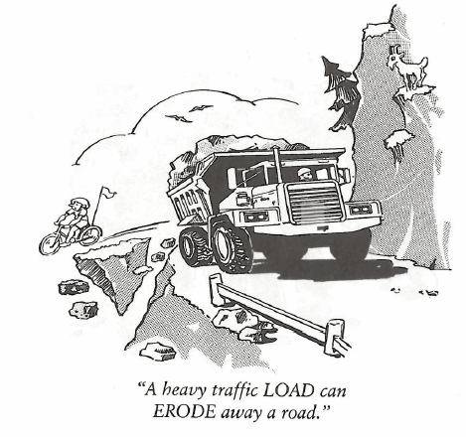
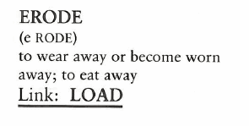
Erode (V)
We sat on the beach and watched the sandcastle ERODE as the tide came in.

Slide 4
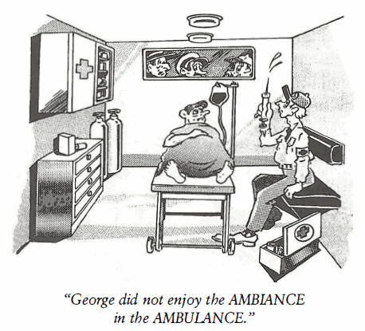
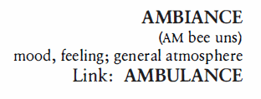
Ambiance (N)
During our date, the AMBIANCE in the Italian restaurant was delightful, there was soft music, candlelight, and singing waiters.

Slide 5
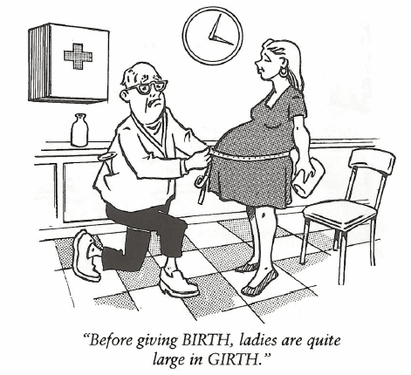
Girth (N, V)
Before crawling through a manhole into a sewer pipe, it is first wise to measure your GIRTH.

Slide 6
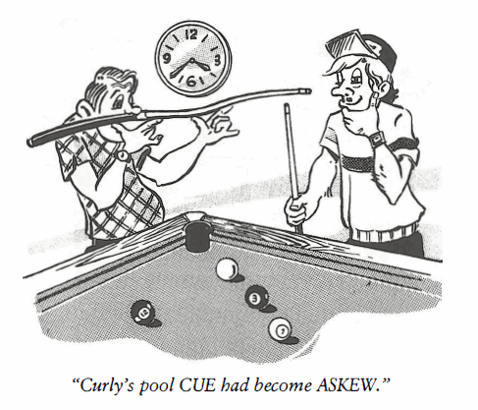
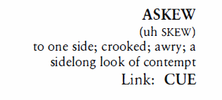
Askew (Adj, Adv)
After the flood receded, the bridge was found to be ASKEW of the road which connected to it.

Slide 7
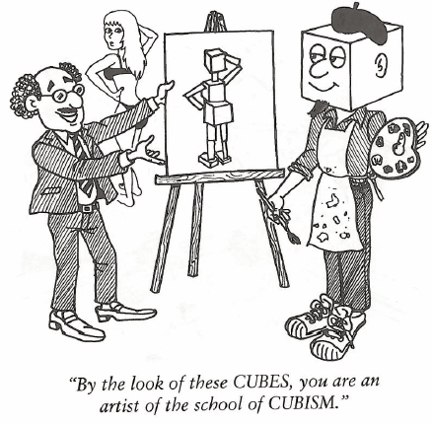
Cubism (N)
CUBISM is a style of art that stresses abstract structure at the expense of other pictorial elements by fragmenting the form of those objects that are to be depicted.

Slide 8
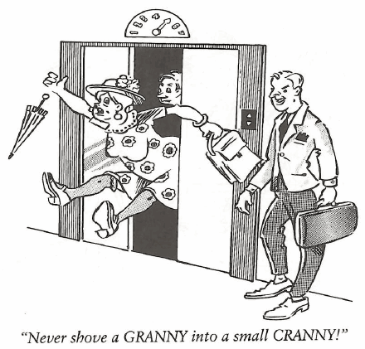
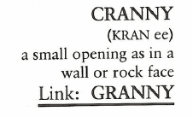
Cranny (N)
Rock climbers look for any CRANNY where they can gain a secure foothold.

Slide 9
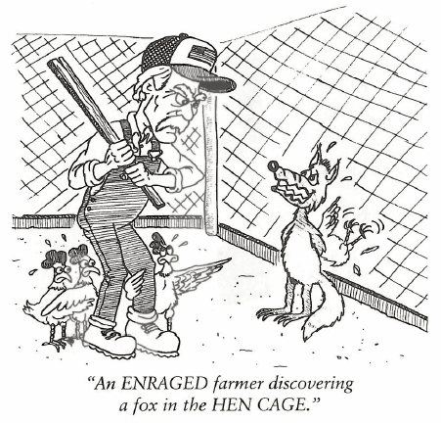
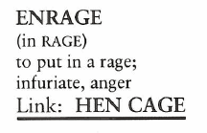
Enrage (V)
Muriel’s boss was ENRAGED when he found out she had gone on her vacation to the Caribbean and left a lot of unfinished work in her desk drawer.

Slide 10
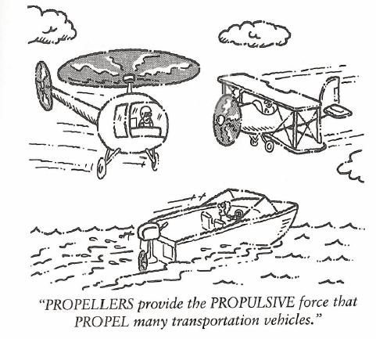
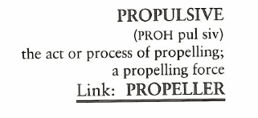
Propulsive (Adv)
The first PROPULSIVE force ship used a PROPELLER invented by Isambard Brunel in 1844.

Slide 11
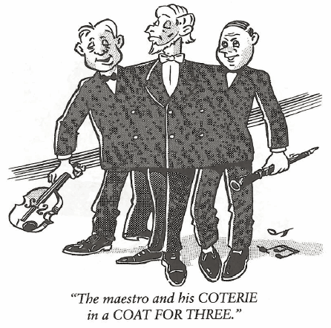
Coterie (N)
Rock stars have a COTERIE of fans who follow them around like leeches.

