Slide 1
Vocabulary 5

Slide 2
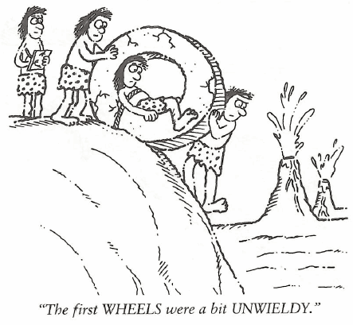
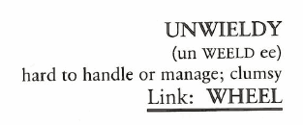
Unwieldy (Adj)
The movie plot was confusing and UNWIELDY; it had so many sub-plots you couldn’t figure out the point the director was trying to make.

Slide 3
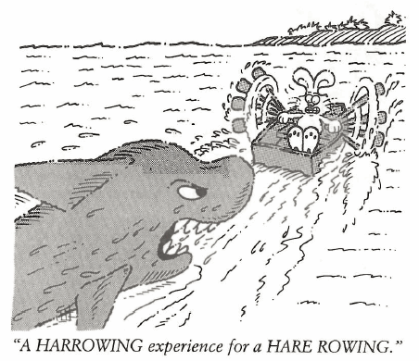
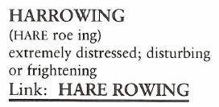
Harrowing (Adj)
(HARRIED is to be troubled or bothered while HARROWING is to be frightened to the extreme.) At first we were HARRIED by the gang members, called names and insulted, but later it became a HARROWING experience as they chased and threatened us with knives.

Slide 4
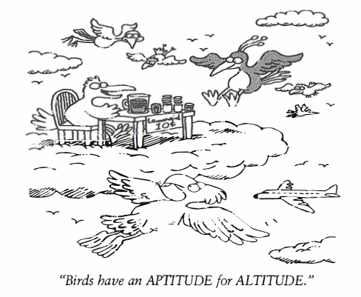
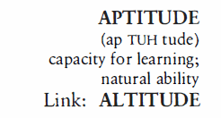
Aptitude (N)
The APTITUDE of flora and fauna to adapt to changing environmental conditions is absolutely marvelous.

Slide 5
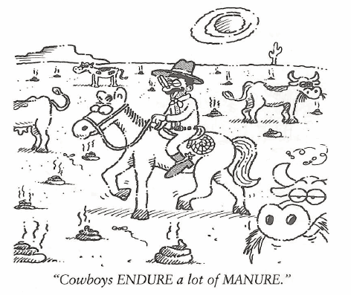
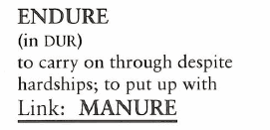
Endure (V)
“I can’t ENDURE the solitude,” Jethro Marks told his lawyer, as the sheriff placed him in an isolation cell while awaiting trial.

Slide 6
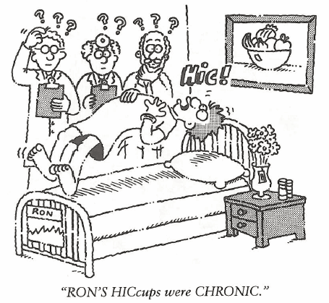
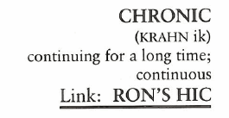
Chronic (Adj)
George was a CHRONIC complainer, he never saw the positive side of anything.

Slide 7
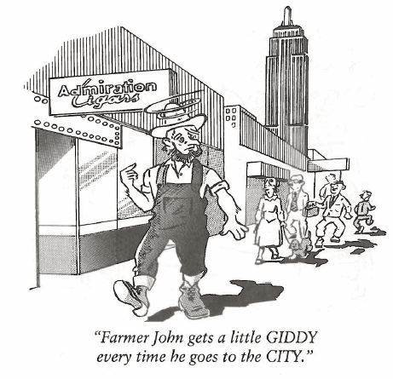
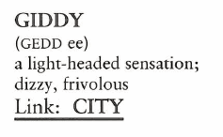
Giddy (Adj, V)
After Sue Ellen won the beauty contest, she was absolutely GIDDY with joy.

Slide 8
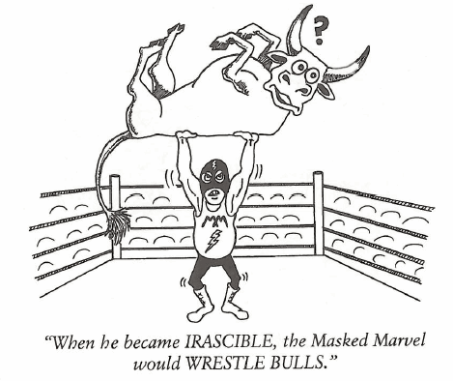
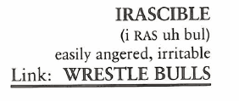
Irascible (Adj)
Normally, Rose was a pleasant wife and mother but if a member of her family prevented her from watching her favorite “game shows,” she could become quite IRASCIBLE.

Slide 9
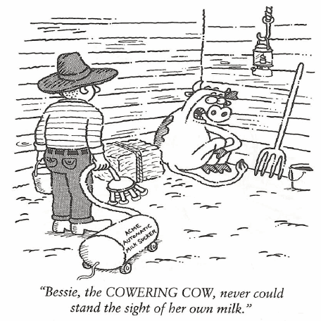
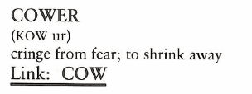
Cower (V)
Jack COWERED in frustration just to think about coming home from vacation and finding all the homework he had to catch up on.

Slide 10
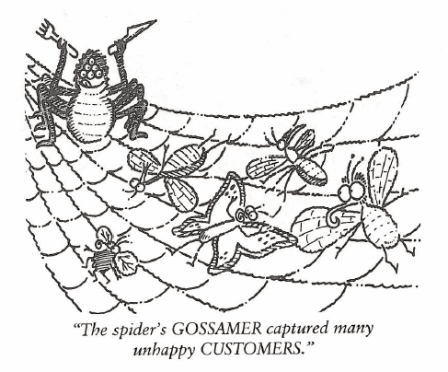
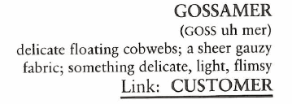
Gossamer (N)
As she proceeded up the aisle to the altar, the bride wore a white silk wedding dress, which touched the floor, and a GOSSAMER veil of fine Italian lace gently touched her face.

Slide 11
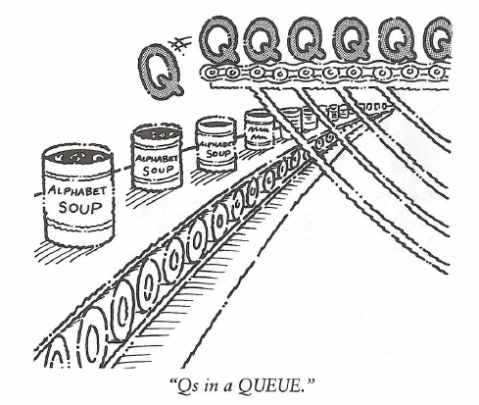
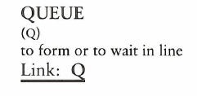
Queue (N,V)
The sisters decided not to attend the movie because a line was QUEUING up as they arrived, and they didn’t want to stand in a long QUEUE in the cold, night air.

