Slide 1
Vocabulary 6

Slide 2
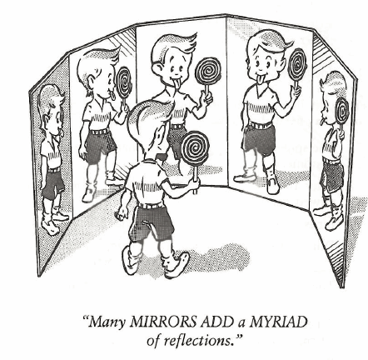
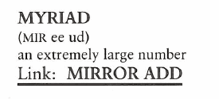
Myriad (N, Adj)
George was a hypochondriac, weighted down by MYRIAD concerns about his health.

Slide 3
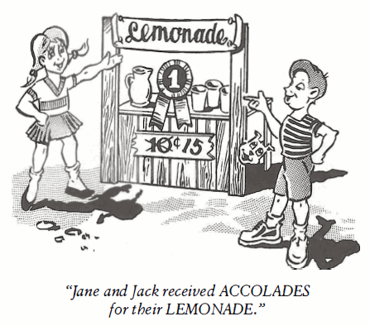
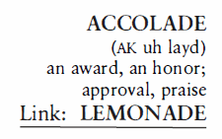
Accolade (N)
The ACCOLADES given our chemistry teacher as the teacher of the year were nothing compared to the ACCOLADES her students gave her when she accidently blew up the lab and class was cancelled for the remainder of the term.

Slide 4
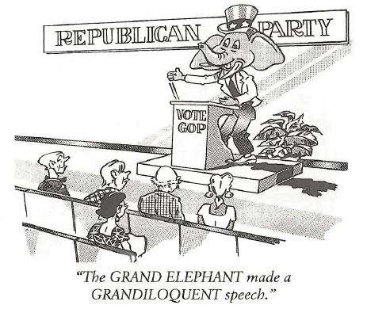
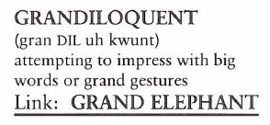
Grandiloquent (Adj)
The new teacher’s GRANDILOQUENCE didn’t fool the class one bit. She really knew very little about computer components.

Slide 5
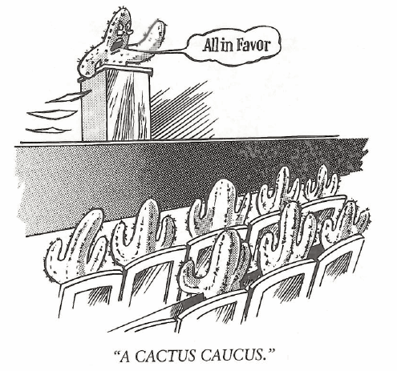
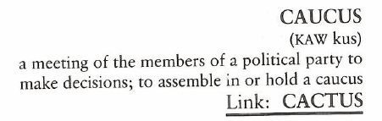
Caucus (N, V)
A CAUCUS was held by the members of the delegation to determine if they should hold a special CAUCUS for the unmarried members.

Slide 6
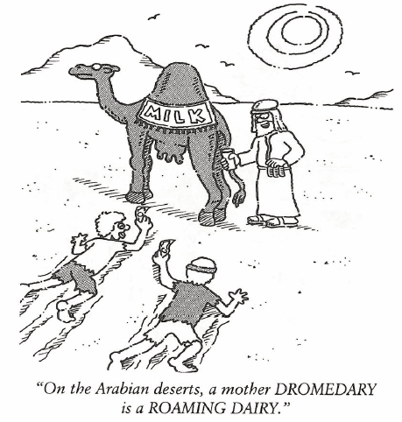
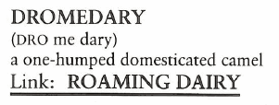
Dromedary (N)
The DROMEDARY is widely used as a beast of burden in Northern Africa and Western Asia.

Slide 7
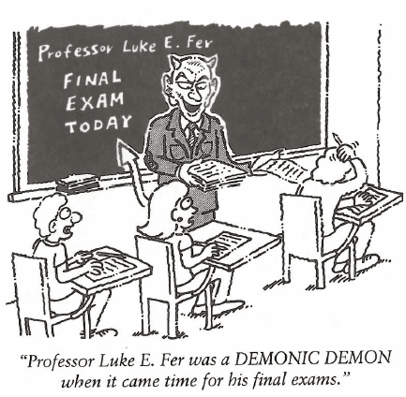
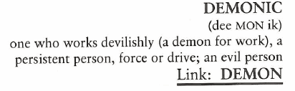
Demonic (Adj)
In pursuit of an Olympic medal, Jack’s practice habits were DEMONIC; six hours a day on the track was his norm.

Slide 8
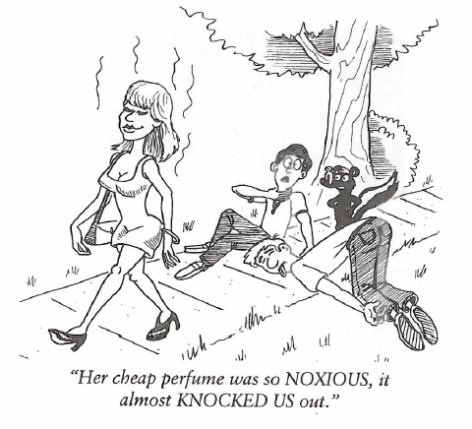
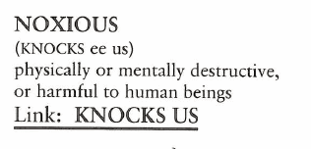
Noxious (Adj)
( OBNOXIOUS is to be exposed to something NOXIOUS.) Jenny’s flirtatious behavior with her best friend’s boyfriend was OBNOXIOUS.

Slide 9
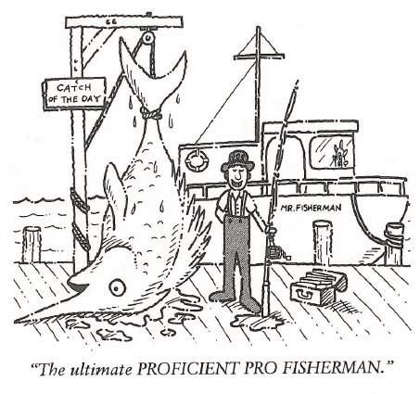
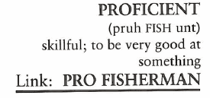
Proficient (Adj, N)
June was so PROFICIENT as an executive secretary she was promoted and became vice-president of sales.

Slide 10
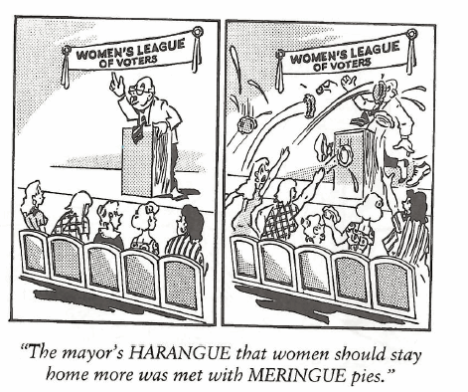
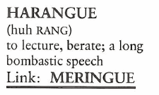
Harangue (N, V)
Our neighbor is a farmer who goes to town once a week on Saturdays and HARANGUES everyone he meets on how bad the government treats farmers.

Slide 11
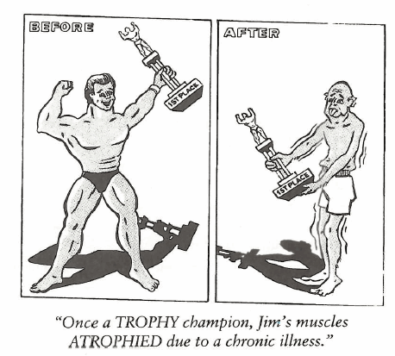
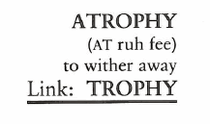
Atrophy (N, V, Adj)
The ATROPHIC condition of the mummy was apparent as soon as the tomb was opened. The withered body was almost unrecognizable as having once being a person.

