Slide 1
Vocabulary 8

Slide 2
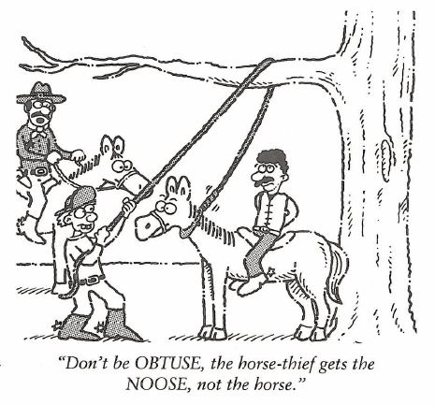
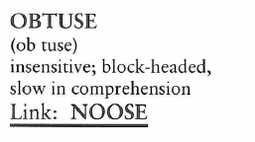
Obtuse (Adj)
Don’t pretend to be so OBTUSE. You know the idea of business investing is to buy low and sell high.

Slide 3
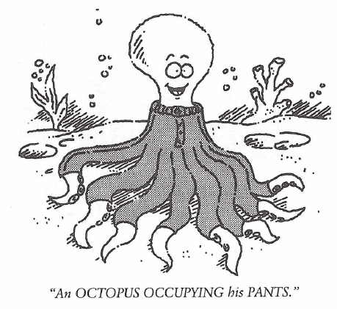
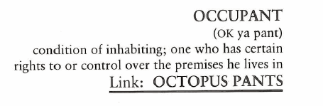
Occupant (N)
Many turtle habitats are occupied by interloper snakes who then become the main OCCUPANTS.

Slide 4
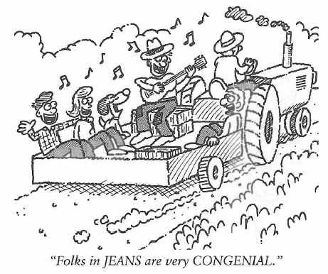
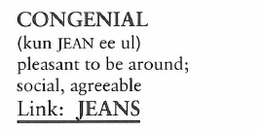
Congenial (Adj)
Because she was so social at gatherings, Miss Florida was voted Miss CONGENIALITY in the Miss America pageant.

Slide 5
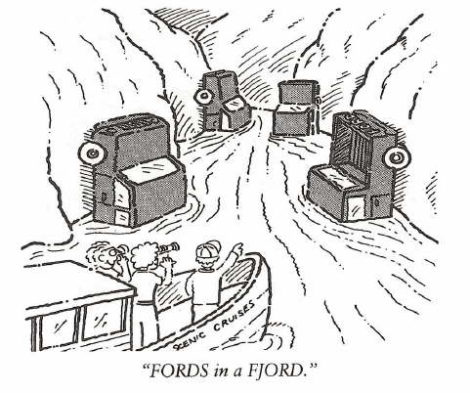
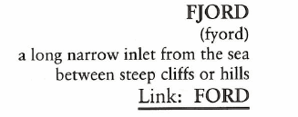
Fjord (N)
FJORDS are generally deep allowing large cruise ships to have more than enough water to navigate up the length.

Slide 6
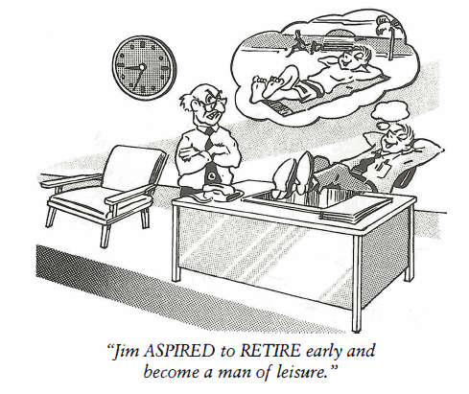
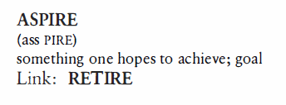
Aspire (V)
The counselor told Jim’s parents his problem in school was he didn’t ASPIRE to anything. He had no current goals or career direction.

Slide 7
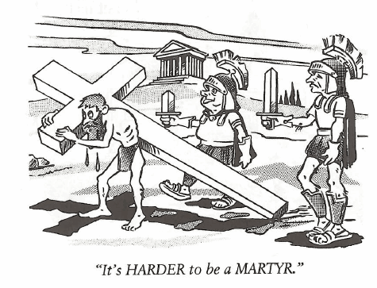
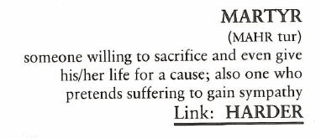
Martyr (N, V)
Joan of Arc was undoubtedly the most famous MARTYR in modern history, burned at the stake because she refused to go against her beliefs.

Slide 8
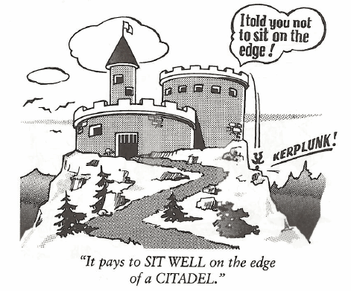
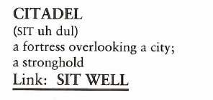
Citadel (N)
West Point is considered a CITADEL of military learning, a fact easily understood when you come to understand most generals attended.

Slide 9
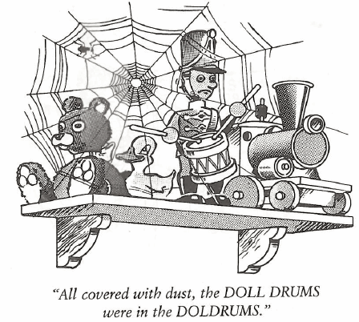
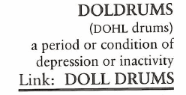
Doldrums (N)
For thirteen days we were becalmed in the Horse Latitudes near the equator—our ship drifting in the DOLDRUMS without the faintest breeze to fill the sails of our vessel.

Slide 10
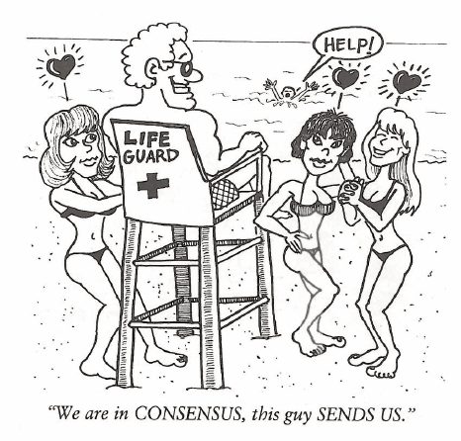
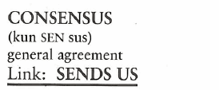
Consensus (N)
A CONSENSUS is more than a majority; it means most everyone agrees.

Slide 11
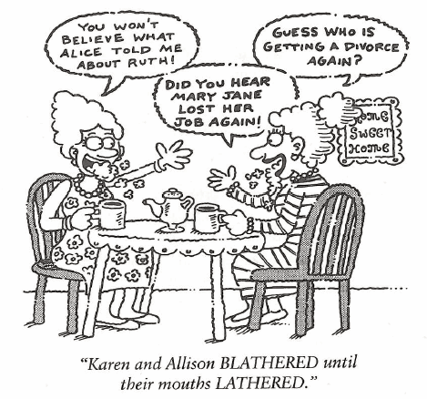
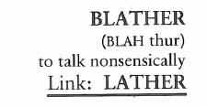
Blather (N, V)
Everything the media reported about the supposed plane disaster never happened. It was a bunch of BLATHER by uninformed journalists.

