Slide 1
Vocabulary 9

Slide 2
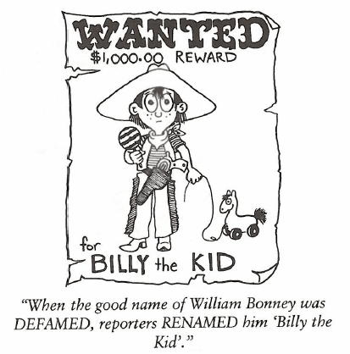
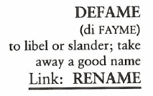
Defame (V)
Thomas Jefferson was once quoted as saying, “DEFAMATION is becoming a way of life insomuch that a dish of tea cannot be digested without the stimulant.”

Slide 3
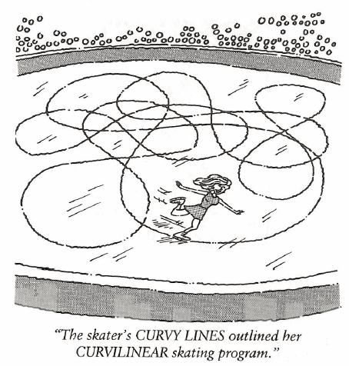
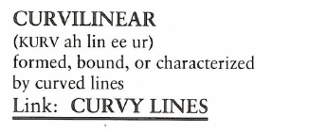
Curvilinear (Adj)
Squares and rectangles have no CURVILINEAR lines.

Slide 4
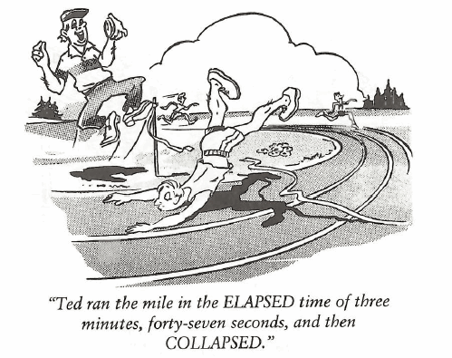
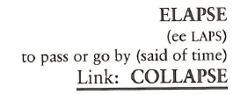
Elapse (V)
During World War II, the siege of Stalingrad lasted five months; in the ELAPSING battle 750,000 Russians and 400,000 Germans died.

Slide 5
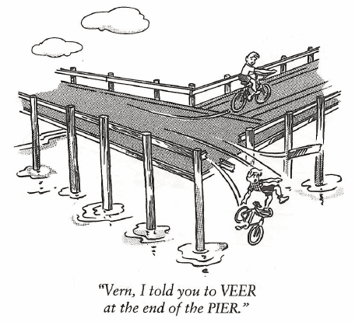
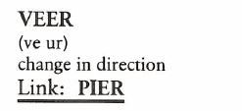
Veer (V, N)
When you arrive at the castle, VEER left around the wall and follow the foot trail until you come to the valley.

Slide 6
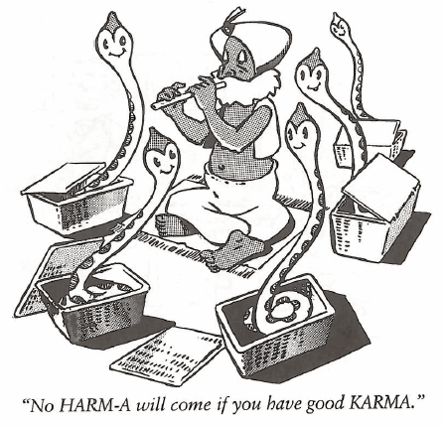
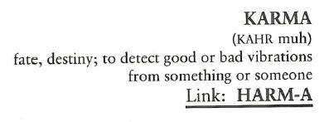
Karma (N)
During the thirteenth century, Genghis Khan emanated a KARMA of death and destruction.

Slide 7
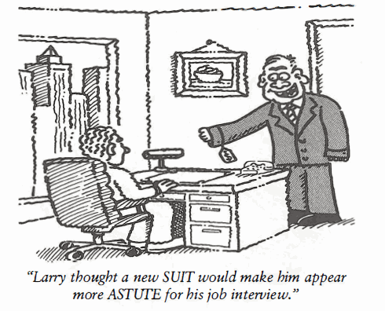
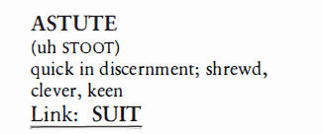
Astute (Adj)
Louisa has a natural ASTUTENESS in dealing with angry people and winning them over to her view, thereby settling matters amicably.

Slide 8
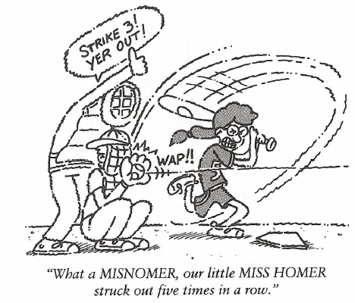
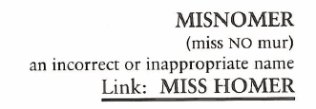
Misnomer (N)
We usually have dinner at this very small Italian restaurant called The Spaghetti Factory, obviously a MISNOMER of major proportions.

Slide 9
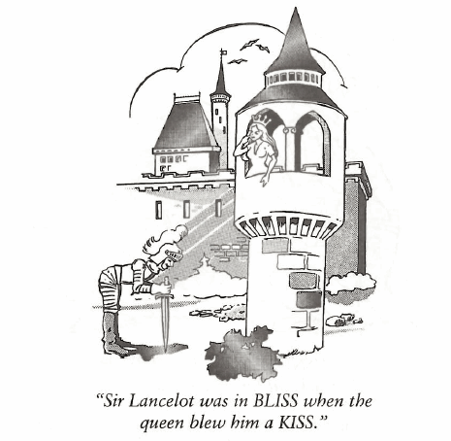
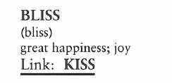
Bliss (N, V)
Jane and Glen said their vacation to Hawaii was pure BLISS; they had very much needed to get away and relax.

Slide 10
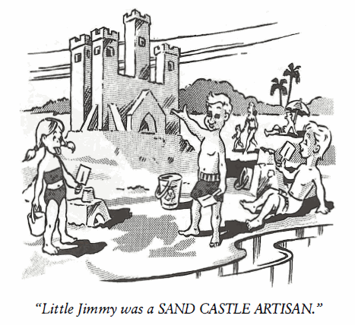
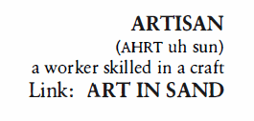
Artisan (N)
The ARTISANS of Pueblo, Mexico are known for their beautiful pottery.

Slide 11
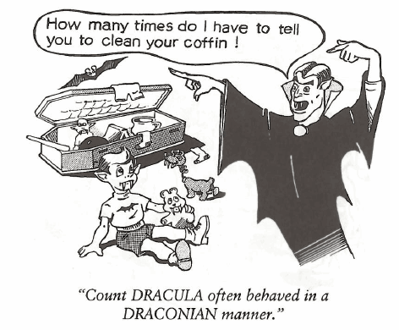
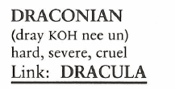
Draconian (Adj)
The word DRACONIAN did not originate with the fictional character, Count Dracula, but with an ancient Greek official named Dracula who created a harsh code of laws.

